Slide 1
Basic Tutorial Part II: w-iLab.t

Slide 2
This part of the tutorial
We learned about Rspecs and jFed
Now we’ll do a real experiment:
http://jfed.iminds.be
Click here more documentation on iMinds iLab.t testbeds
Go to tutorials on the bottom

Slide 3
Saving RSpec
Go to the experiment definition
Save the Rspec
Look at it in an editor
Load it again

Slide 4
Recover and automate
Now we will close jFed and start an alpha version with new features:
http://jfed.iminds.be , Alpha jFed
Click recover and click your experiment
Nodes should become green
Click experiment controller
Do an instant command on all nodes
ps aux|grep hostapd
sudo apt-get install dstat
Kill iperf server and add an event for server and client, see next slide

Slide 5
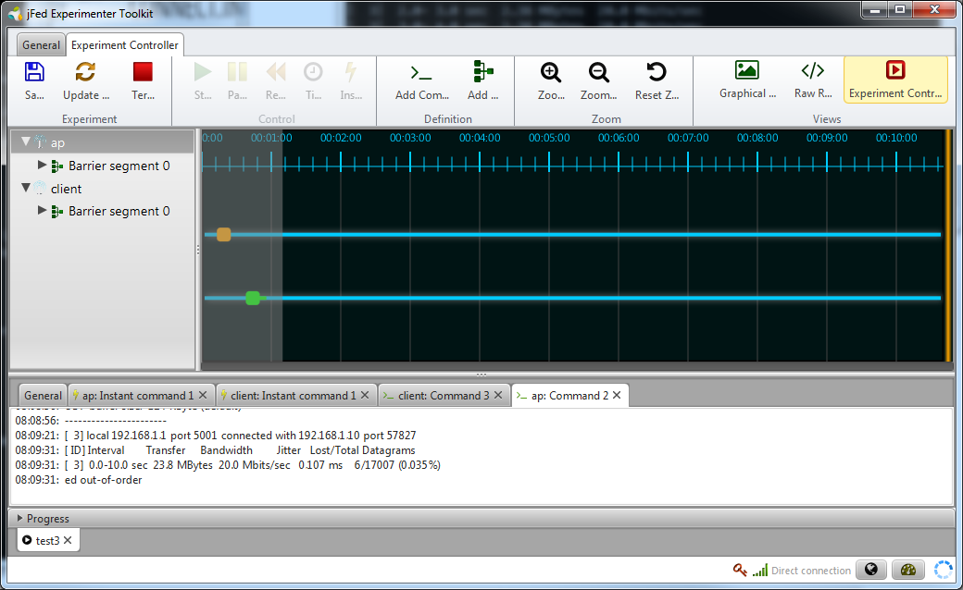

Slide 6
Extra stuff
See documentation:
http://fed4fire-testbeds.ilabt.iminds.be/ilabt-documentation/
E.g. Install tarballs
Same scenario for Virtual Wall machines or VMs !
Storage
On each node: /groups/wall2-ilabt-iminds-be/project
Can be used as permanent storage
Shared between all your nodes
Future:
Also creating images with jFed

