Slide 1
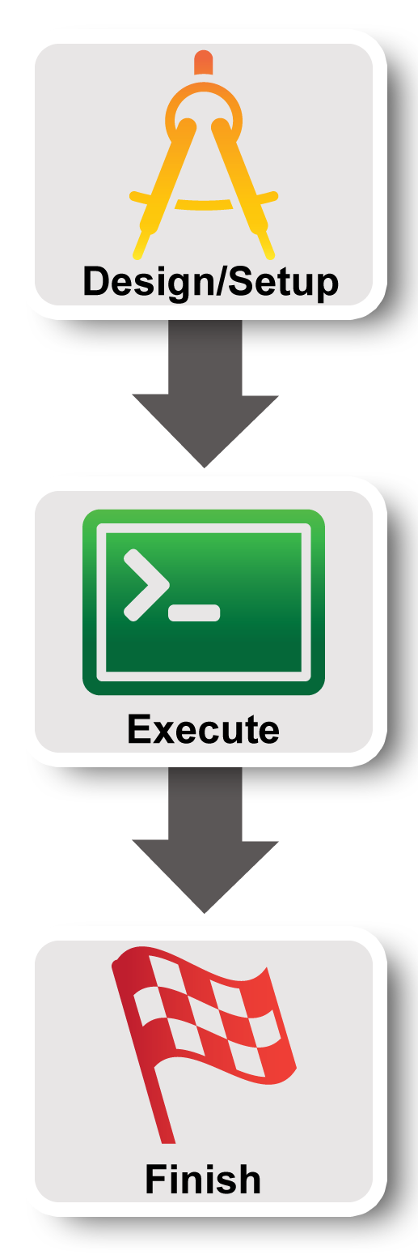
Lab Zero:
A First Experiment

Slide 2

Hands On Exercise
Do a Simple Experiment
Reserve two machines connected at Layer 2
VM
VM
Layer 2
Notes:
There are three goals for today ….
First, jump right in and use GENI to do a very simple (layer 2) experiment

Slide 3
Understand Terminology
project
slice
experimenter
resource
aggregate
Notes:
Second goal is to understand and use some GENI terminology.

Slide 4
Experiment Workflow
Part I: Design/Setup
Part II: Execute
Part III: Finish
Notes:
We’ve split the experiment into several parts. Before each of these sections, we’ll talk about the concepts and terms you will need for each section.
The logo on the left is intended to act as a guidepost to help you keep track of where you are.

Slide 5
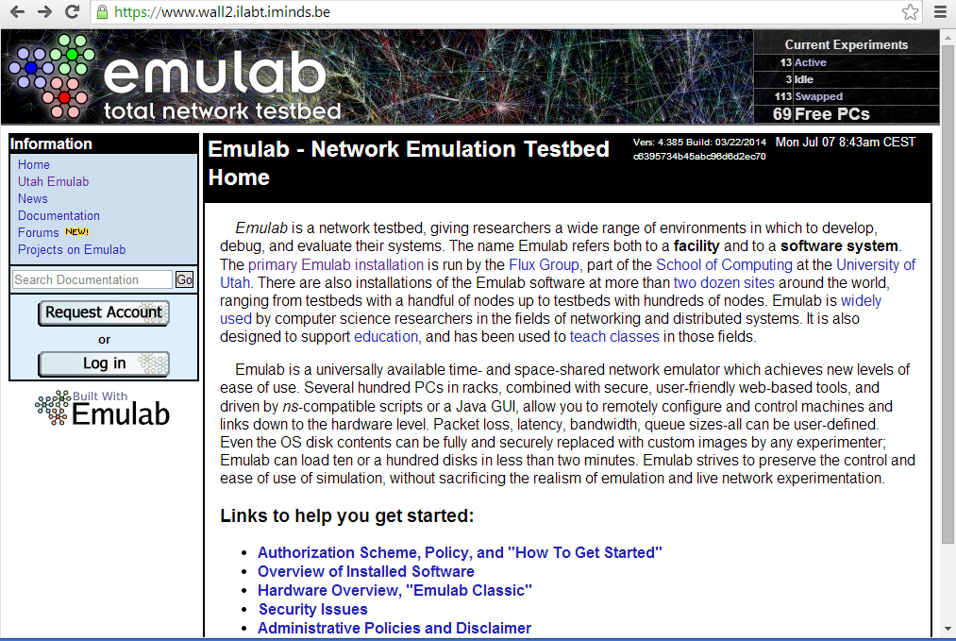
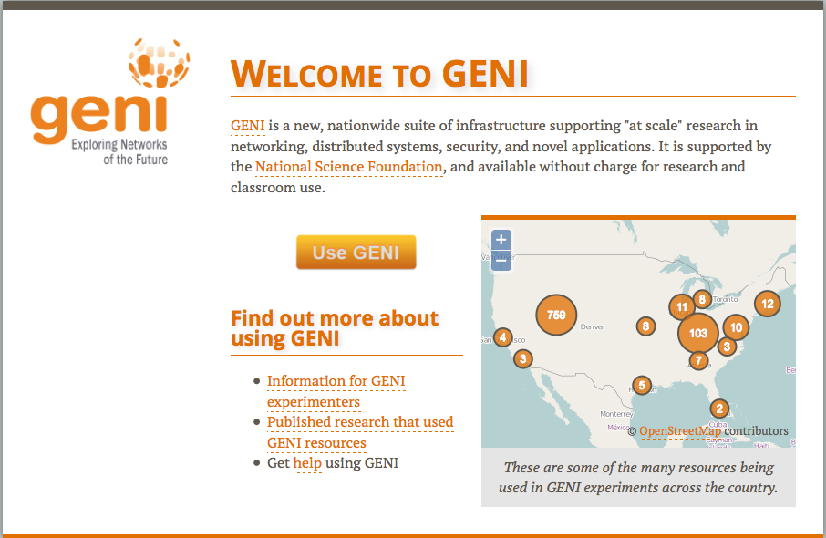
Create accounts
Notes:
Third goal is to learn how to use the GENI Experimenter Portal and Flack to do this experiment in GENI.
Note that the portal and Flack are built with GENI in mind so they reflect GENI terminology and concepts.

Slide 6
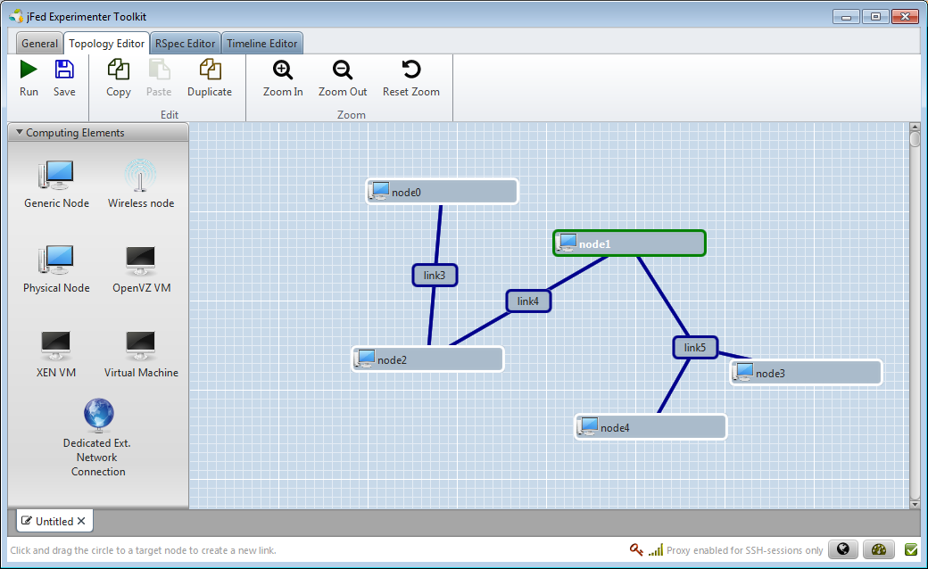
jFed is …
A graphical user interface (GUI) for:
  designing topologies
  reserving resources
Notes:
Flack is a tool that is integrated into the portal which provides a graphical user interface for designing and reserving topologies in GENI.

Slide 7
Experimenter
An experimenter is a researcher who uses GENI/FIRE resources
Different types of experimenters have different roles and permissions:
Advisor vs Grad Student
Teacher vs TA vs Student
Experimenter
Notes:
An experimenter is a researcher who uses GENI resources.
Different experimenters will have different roles in GENI and therefore different permissions.
For example, …..

Slide 8
Projects
Project
Slice
Lead
Projects organize research in
GENI/FIRE
Members
  Projects contain both people and their experiments
A project is led by a single responsible individual:
the project lead
Today we will use a
project created for this class
Notes:
Experimenters can perform experiments in the context of a project.
Projects contain both people and their experiments. (Experiments are represented by slices, a term we will define in a few minutes.)
A project must have a single individual who is willing to take responsibility for what happens within the project. This person is called the project lead.
For our purposes today, we will use a project created for this class and the professor will be the project lead.

Slide 9
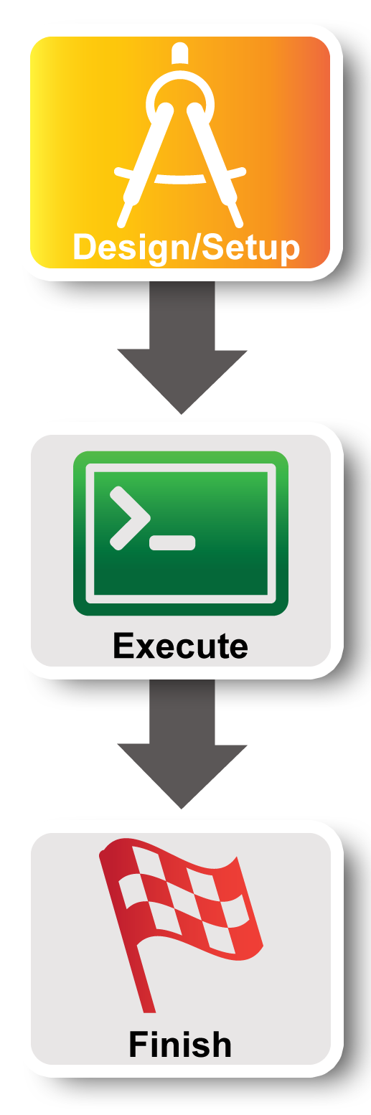
Experiment Workflow
Part I: Design/Setup
Part II: Execute
Part III: Finish
Notes:
Now we’re ready for part I. We will start by making sure we have the right access to GENI resources. This is mostly ** one-time setup **.

Slide 10
Creating an account
GENI Portal is at:
  https://portal.geni.net
Instructions for creating an account are:
http://groups.geni.net/geni/wiki/SignMeUp
Instructions FIRE: http://doc.fed4fire.eu
  Authority: www.wall2.ilabt.iminds.be
  Join project: fgre
Notes:
*** If you haven’t already logged in, please do so now. If you are having trouble please raise your hand and someone will come help you. ***
Anyone with an account at a supported identity provider can log in to the GENI portal but they will have no privileges. You must be a member of a project to do anything interesting.

Slide 11

ssh with a public/private keypair
Login to all compute resources using
ssh with a private key
There are several ways to offer your private key to ssh. Today we will use a tool called an ssh agent.
$ ssh-add ~/.ssh/id_geni_ssh_rsa
$ ssh username@hostname -p 12345
No password!
You should never be prompted for a password to log into a compute node.
Notes:
Today we will use a tool called an ssh agent to offer your private key to ssh.
On many flavors of Unix/Linux (but not all) the ssh agent runs by default.
You will open a terminal on your local machine and run ssh-add to add the ssh private key to your ssh agent.
Then when you ssh the usual way, the agent will offer your private key to the server on your behalf without any further effort on your part.
Note, that if a GENI node you are logging into asks for a password, something has always gone wrong and you should ask for help.

Slide 12
Expiration and renewal
project
slice
resource
resource
resource
(optional)
project
expiration time
resource
expiration time
slice
expiration time
now
slice expiration time ≤ project expiration time
each resource expiration time ≤ slice expiration time
each resource expiration time ≤ aggregate’s max expiration
In general, to extend the lifetime of your resource reservation, you must renew the slice and all resources
Notes:
GENI resources are provided by free on a first-come-first-serve basis. GENI uses a variety of expiration times to ensure resources are returned to the pool of available resources in a timely manner.
To start with, projects have an optional expiration time.
A slice created within that project has a slice expiration time that can not be any later than the project expiration time.
Resources reserved within that slice have an expiration time that can not be later than the slice’s expiration time. Moreover, different resources within the same slice may have distinct expiration times.
In general, to extend the lifetime of your resource reservation, you must renew both the slice and all resources within that slice.

Slide 13

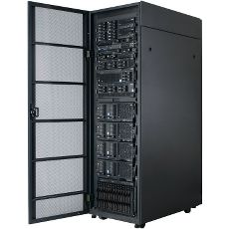
Resource
A resource is a piece of infrastructure
A resource can be real or virtual.
Resource specifications (aka. RSpecs) are used to describe and request resources.
Examples:
Compute: computer vs virtual machine (VM)
Wireline Network: VLAN or OpenFlow
Wireless: WiMAX
Notes:
A resource is something you can reserve -- like a computer or network. Resources can be real or virtualized.
The description of the resources you want to reserve are called a resource specification (abbreviated RSpec).

Slide 14
Slice
A slice is a container of resources used in an experiment.
A slice can contain resources from one or more aggregates
A slice is in a single project
A slice has an expiration
Slice names are public, reusable and unique (within a project)
Notes:
A slice is a container for the resources you are using in your experiment.
A slice usually contains resources from multiple aggregates. A slice belongs to a single project and has an expiration. And slice names are unique within a project (as of mid-November 2013).

Slide 15

Putting it all together
project
Lead:
Member:
Experimenter
(aka Professor)
Experimenter
(aka Student)
slice
aggregate
resource
resource
Layer 2
Notes:
15
For today’s experiment we are reserving two resources which are VMs.
We are reserving those VMs at a single aggregate.

Slide 16
Part I continued:
Obtain Resources
slice
VM
VM
Layer 2
3.1 Create a slice
3.2 (optional) Renew your slice
3.3 Reserve two VMs at on aggregate
3.4 Check Whether VMs are Ready to be Used
Notes:
First, we will create a slice.
Second, we will optionally renew the slice.
Third, we will reserve resources at two aggregates. There is real work happening here as the nodes are reserved.
Fourth, we’ll determine if the virtual machines have booted and are ready for use.

Slide 17
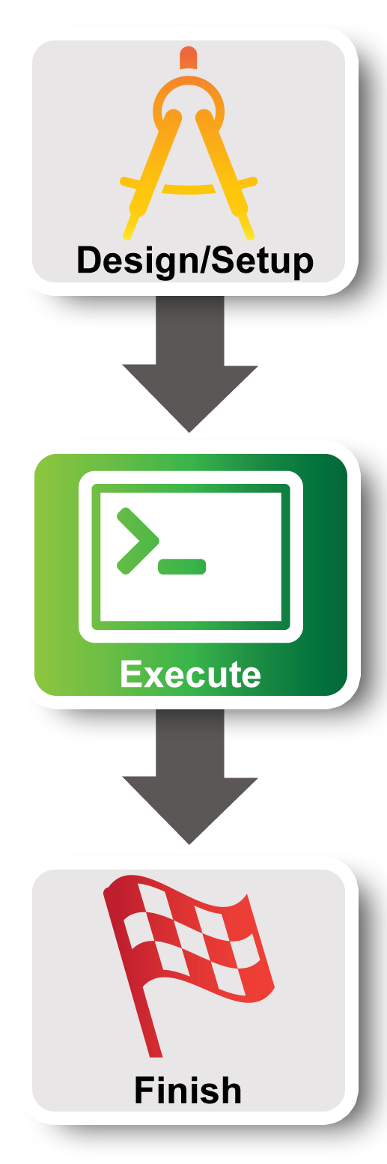
Experiment Workflow
Part I: Design/Setup
Part II: Execute
Part III: Finish
Notes:
In Part II we will execute the meat of the experiment….

Slide 18
Internet
Control plane switch
eth___
___.___.___.___
eth___
___.___.___.___
client
Data plane switch
server
Control i/f
Control i/f
Data i/f
eth___
Data i/f
eth___
10.1.1.1
10.1.1.2
GENI Rack

Slide 19
Part II:
Execute Experiment
Experimenter
Internet
ssh
Control Interfaces
client
Layer 2
server
Data Interfaces
4.1 Login to nodes (two nodes: client & server)
5 Execute experiment
5.1 Send IP traffic
5.2 Install and use iperf
5.3 Bring down the server’s data interface
5.4 Bring down the server’s control interface
6.1 Logout of nodes
Notes:
We have two nodes (“client” and “server”) and they each have two interfaces. The control interface connects to the public internet and is the interface you use to login to your nodes. The data interface is what we use for the experiment: it’s connected to the VLAN.
We will log into our nodes.
Then we will run our experiment ….
When we are done we’ll log out.

Slide 20
5.1
$ sudo ifconfig
$ ping 10.1.1.2 –c 5 # server data i/f
$ ping 172.17.1.9 –c 5 # server ctrl i/f
client
5.1
$ sudo ifconfig
server
Notes:
log into your two VMs
Next run ifconfig….
STOP and ….

Slide 21
Worksheet
5.1
Project Name: GEC20
Slice Name: lab0<your initials>
Internet
Control plane switch
eth___
___.___.___.___
eth___
___.___.___.___
client
Data plane switch
server
Control i/f
Control i/f
Data i/f
eth___
Data i/f
eth___
10.1.1.1
10.1.1.2
GENI Rack
Notes:
… fill in your worksheet. This is really important.
Be careful.
** Live portion **

Slide 22
$ sudo apt-get install iperf
$ hash
# server data i/f
$ iperf –c 10.1.1.2
…
5.2
$ sudo apt-get install iperf
$ hash
# start an iperf server
$ iperf -s
client
server
Notes:
Ping the server’s data interface. This should succeed. Let us know if this doesn’t work and we’ll help you debug it.
Ping the server’s control interface. This should also succeed.

Slide 23
What is the bandwidth of the data link? Why?
What is the bandwidth of the control link? Why?
5.2
Internet
Control plane switch
eth___
___.___.___.___
eth___
___.___.___.___
client
Data plane switch
server
Control i/f
Control i/f
Data i/f
eth___
Data i/f
eth___
10.1.1.1
10.1.1.2
GENI Rack
Notes:
What is the bandwidth of the data link? Why?
The bandwidth of the data link is about 100 Mbps which is the default.
What is the bandwidth of the control link? Why?
A lot more. Because you get the full available link.

Slide 24
5.4
When you bring down the data interface, the destination should become unreachable. Why?
Internet
Control plane switch
eth___
___.___.___.___
eth___
___.___.___.___
client
Data plane switch
server
Control i/f
Control i/f
Data i/f
eth___
Data i/f
eth___
10.1.1.1
10.1.1.2
GENI Rack
Notes:
When you bring down the data interface, the destination should become unreachable.
Why?
The client can no longer reach that interface on the server.
After you bring down the control interface, your ssh session should immediately hang.
Why?
You brought down the interface you were using to log into the node.
After you bring down the control interface, the destination should become unreachable.
Why?
The client can no longer reach that interface on the server.

Slide 25
5.4
After you bring down the control interface, the destination becomes unreachable. Why?
Internet
Control plane switch
eth___
___.___.___.___
eth___
___.___.___.___
client
Data plane switch
server
Control i/f
Control i/f
Data i/f
eth___
Data i/f
eth___
10.1.1.1
10.1.1.2
GENI Rack
Notes:
When you bring down the data interface, the destination should become unreachable.
Why?
The client can no longer reach that interface on the server.
After you bring down the control interface, your ssh session should immediately hang.
Why?
You brought down the interface you were using to log into the node.
After you bring down the control interface, the destination should become unreachable.
Why?
The client can no longer reach that interface on the server.

Slide 26
5.4
After you bring down the control interface, your ssh session should immediately hang. Why?
Internet
Control plane switch
eth___
___.___.___.___
eth___
___.___.___.___
client
Data plane switch
server
Control i/f
Control i/f
Data i/f
eth___
Data i/f
eth___
10.1.1.1
10.1.1.2
GENI Rack
Notes:
When you bring down the data interface, the destination should become unreachable.
Why?
The client can no longer reach that interface on the server.
After you bring down the control interface, your ssh session should immediately hang.
Why?
You brought down the interface you were using to log into the node.
After you bring down the control interface, the destination should become unreachable.
Why?
The client can no longer reach that interface on the server.

Slide 27
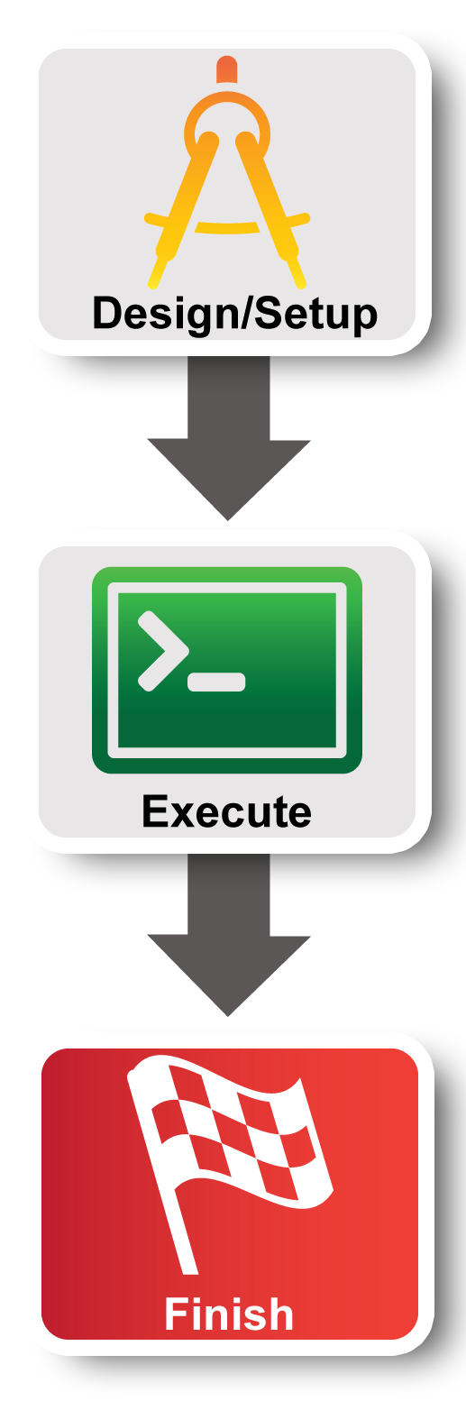
Experiment Workflow
Part I: Design/Setup
Part II: Execute
Part III: Finish
Notes:
The third part of the experiment is when you would normally archive any data and release your resources.

Slide 28

Part III:
Finish Experiment
project
resource
experimenter
aggregate
slice
When your experiment is done, you should always release your resources.
  Normally this is when you would archive your data
  Delete your resources at each aggregate
Notes:
Be sure to delete your resources.

Slide 29
Congratulations!
You have…
  Run your first Experiment!
  Exercised your knowledge of terminology
Notes:
When we started, we promised to do three things.
You’ve run your first GENI experiment.
You’ve hopefully developed a more concrete understanding of GENI terminology.
You have used the GENI portal and Flack

Slide 30
Welcome
to GENI-FIRE!

Slide 31
Working With Collaborators

Slide 32
Projects
Project
Slice
Lead
Projects organize research in GENI
Members
  Projects contain both people and their experiments
A project is led by a single responsible individual:
the project lead
Notes:
Experimenters can perform experiments in the context of a project.
Projects contain both people and their experiments. (Experiments are represented by slices, a term we will define in a few minutes.)
A project must have a single individual who is willing to take responsibility for what happens within the project. This person is called the project lead.
For our purposes today, we will use a project created for this class and the professor will be the project lead.
Only project leads can create projects.
Project names are public, unique and permanent
A project may contain many experimenters; an experimenter may be a member of many projects

Slide 33
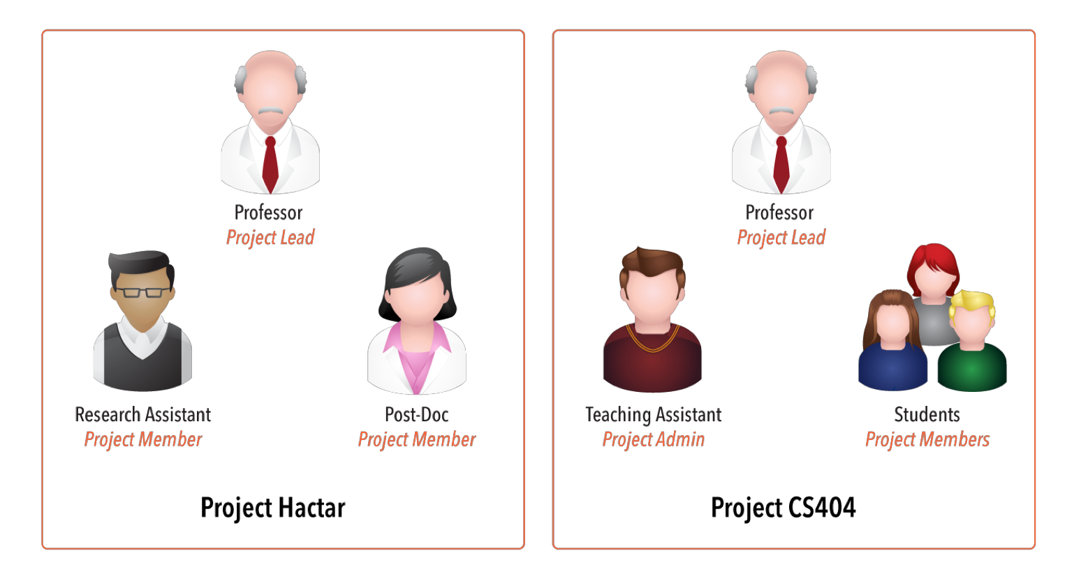

Project Membership example
Projects have 1 Lead and any number of Admins, Members, and Auditors
Expiration
Typical Research Project
Typical Class
http://groups.geni.net/geni/wiki/GENIConcepts#Project
Notes:
Calendar clipart: http://all-free-download.com/free-vector/vector-clip-art/table_calendar_clip_art_12117.html
Projects have an optional expiration (e.g. for classes, tutorials)
For classes it is recommended to have the project expire at the end of the class.

Slide 34
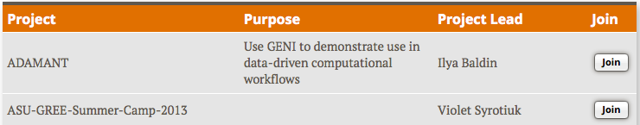
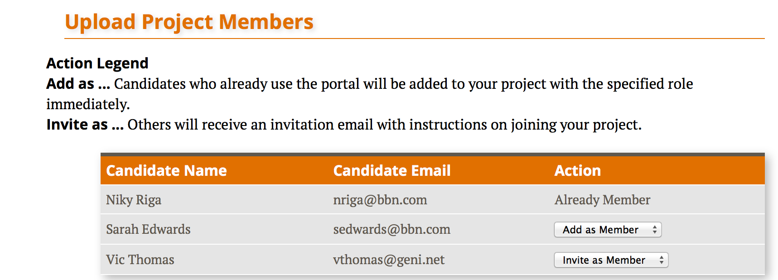
Populating a Project
Member-initiated
  Each experimenter asks to join a project, approval needed
    Typical for Research projects
Admin-initiated
  Project Lead/Admin bulk-adds experimenters
    Typical for Classrooms or Tutorials

Slide 35
Project and Slice Roles
 |  | Create project | Modify project & manage membership | Create slice | View project
Project | Lead | ✔ | ✔ | ✔ | ✔
 | Admin |  | ✔ | ✔ | ✔
 | Member |  |  | ✔ | ✔
 | Auditor |  |  |  | ✔
 |  | Manage slice membership | Act on slice | View slice | Account/ keys loaded on slice
Slice | Lead | ✔ | ✔ | ✔ | ✔
 | Admin | ✔ | ✔ | ✔ | ✔
 | Member |  | ✔ | ✔ | ✔
 | Auditor |  |  | ✔ | ✔
http://groups.geni.net/geni/wiki/ProjectSlicesRoles
Notes:
Project role definitions: http://groups.geni.net/geni/wiki/GENIGlossary#Project
Slice role definitions: http://groups.geni.net/geni/wiki/GENIGlossary#Slice

Slide 36
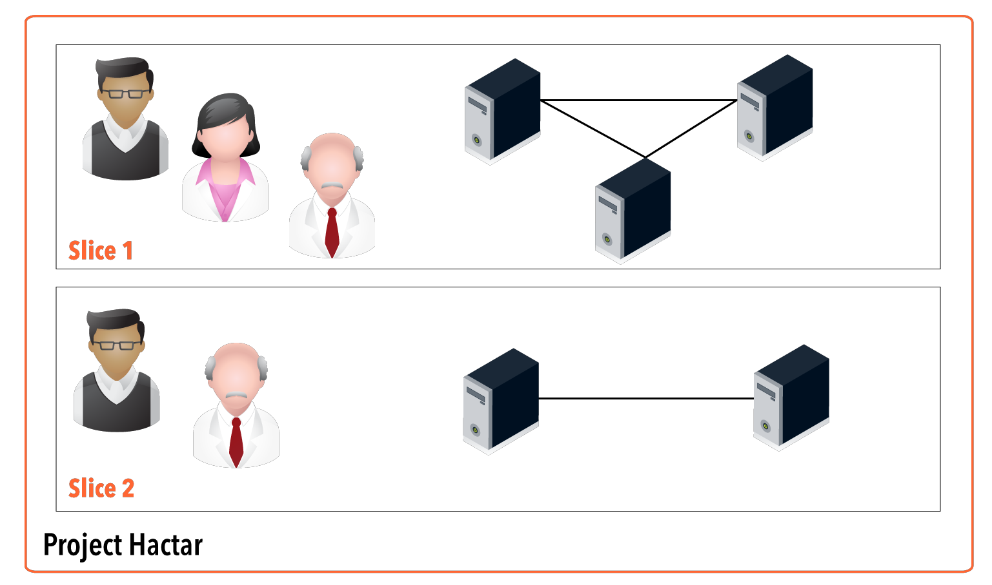
Working with multiple members in a slice
Members of all slices in a project:
Project Leads (Professor)
Project Admins (TAs, Graders)
Other can be added manually
Research Asst
Slice Lead
Post-Doc
Slice Member
Professor
Slice Admin
http://groups.geni.net/geni/wiki/GENIConcepts#Slice

Slide 37
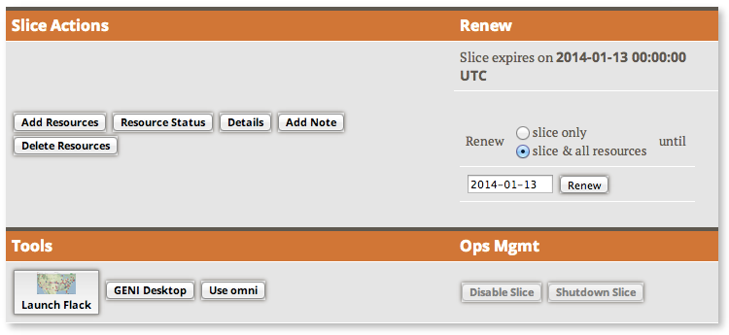
Slice Access
Being a member of a slice means you can act on a slice:
  Add resources
  Check status
  Delete resources
  Renew resources
With any tool!

Slide 38

Slice Access: Logging in to resources
Slice membership does not guarantee ability to login to resources!
To ensure access in collaborator’s resources:
  Option 1: Make resource reservation from Portal
    fix the membership of the slice
    Use the add resource button in the portal
  Option 2: Make resource reservation using omni
    fix the membership of the slice
    Call createsliver
  Option 3: Ensure common public key is loaded
    distribute common public key to collaborators
    ask collaborators to upload it in their profile
    use corresponding private key to login
Notes:
Add options

