Slide 1
Tutorial emulation/cloud
July 8th
Brecht Vermeulen

Slide 2
How to build a larger experiment

Slide 3
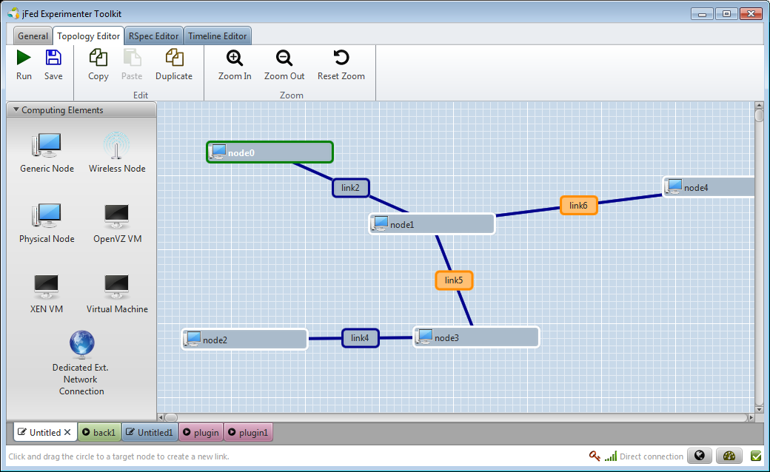
Build backbone on 3 testbeds

Slide 4
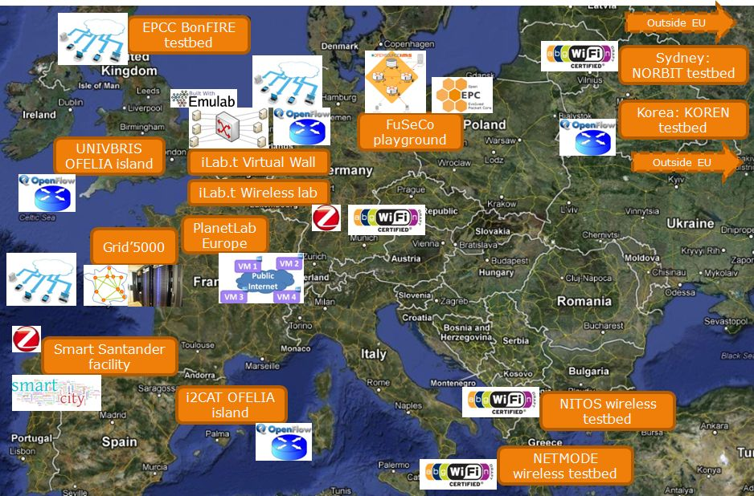
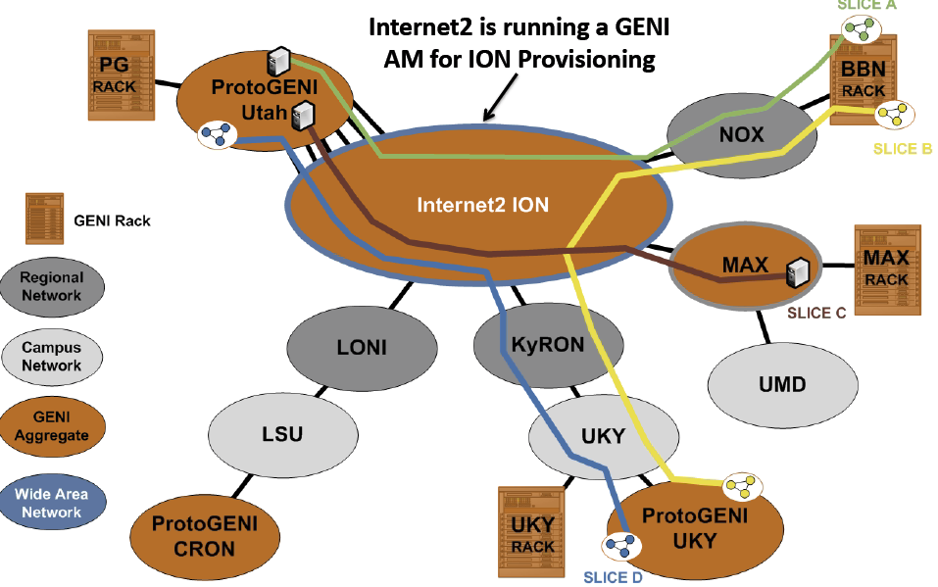
Layer 2 connectivity = stitching VLANs
AUTOBAHN
SDX
STATIC
VLANS
SDX = software defined exchange
eases connectivity (=exchange)
VLAN translation needed + SDN functionality

Slide 5
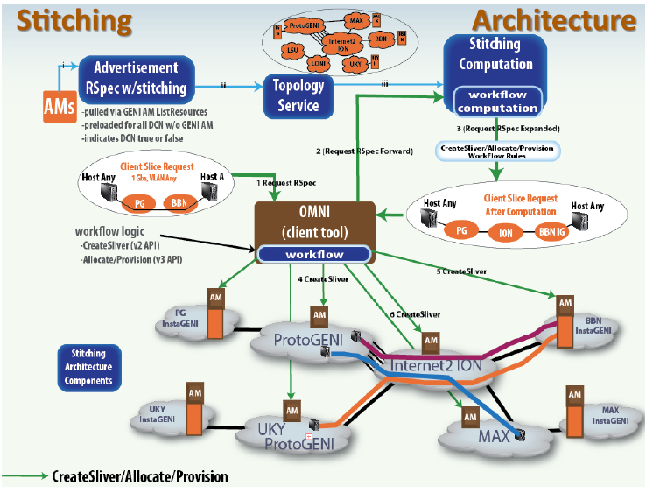
iMinds
SDX
FIRE

Slide 6
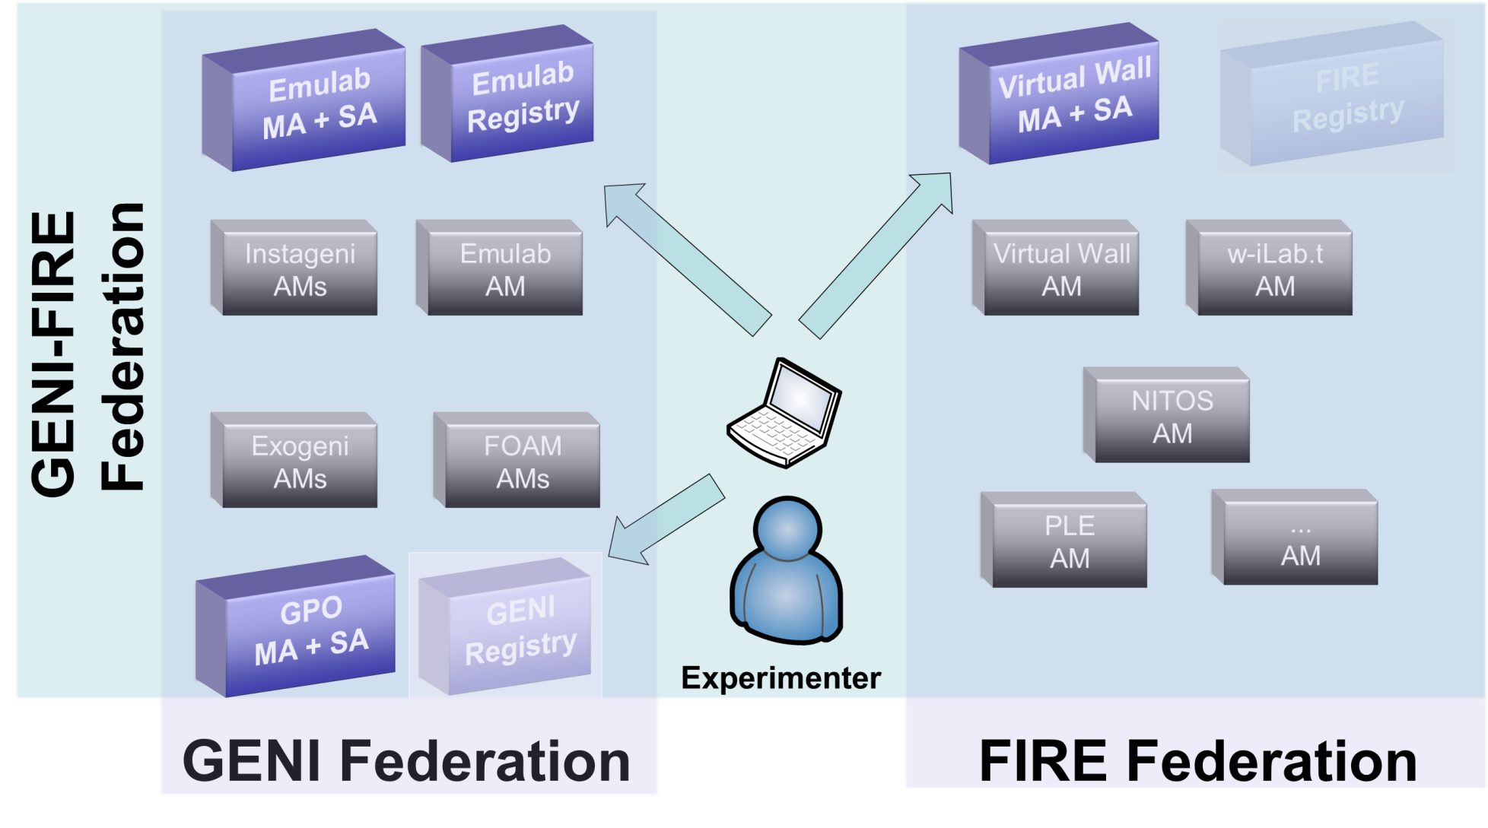
SCS per federation
SCS
SCS
SCS

Slide 7
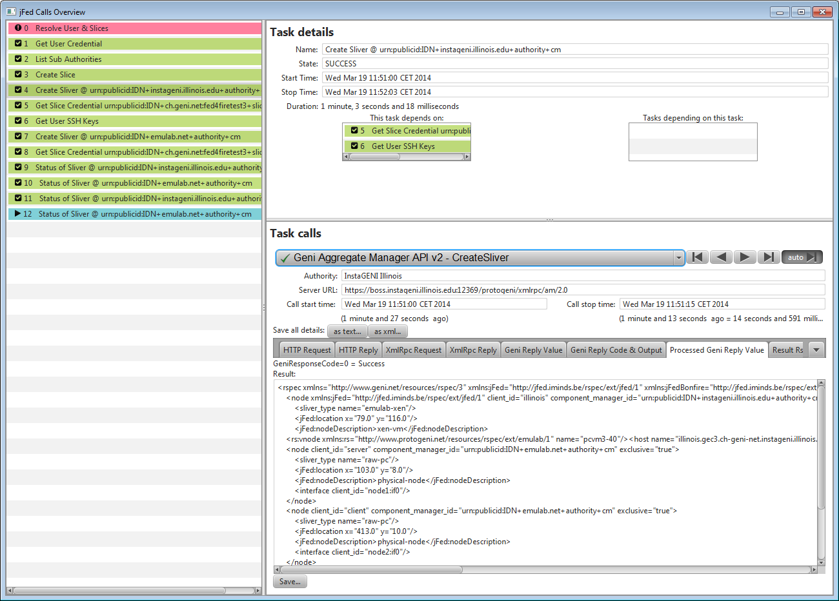
Debug by looking into API calls

Slide 8
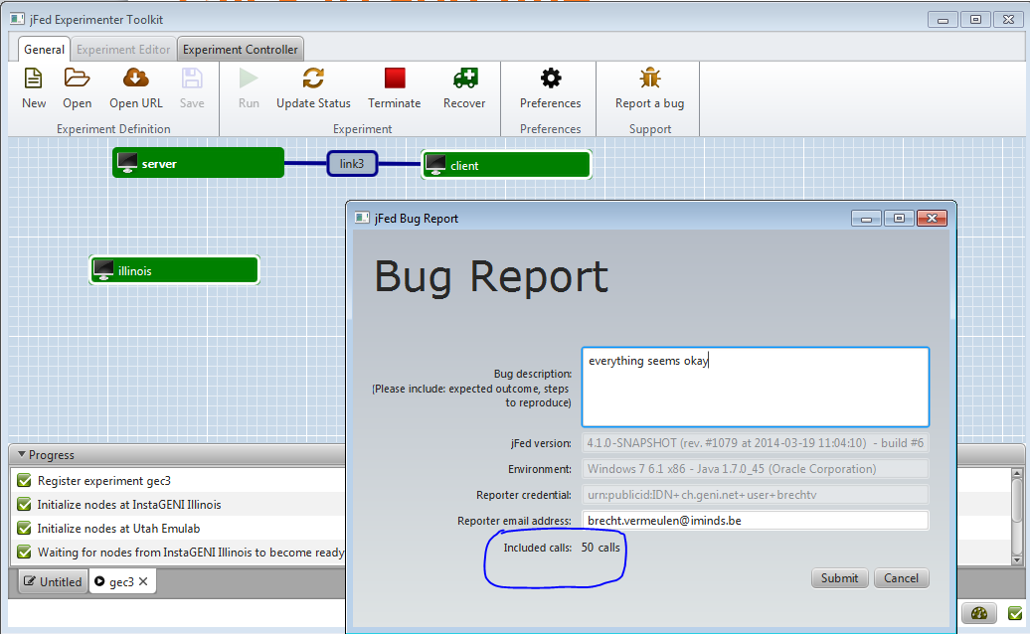
Bug reports and support

Slide 9
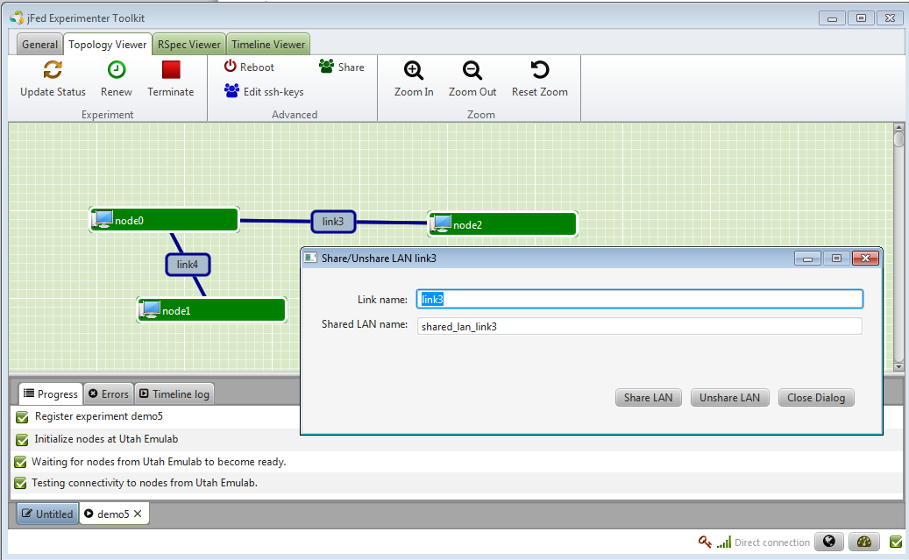
Using shared lans

Slide 10
Sharedlan
<link client_id="link2">
<component_manager name="urn:publicid:IDN+wall2.ilabt.iminds.be+authority+cm"/>
<link_type name="lan"/>
<sharedvlan:link_shared_vlan name="wall2"/>

Slide 11
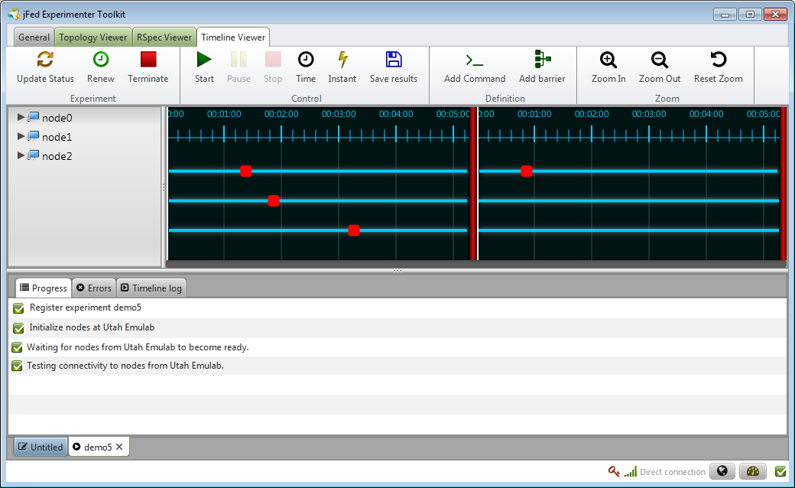
Using some automation and scripts

Slide 12
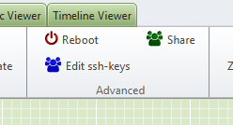
Collaborate with others

Slide 13
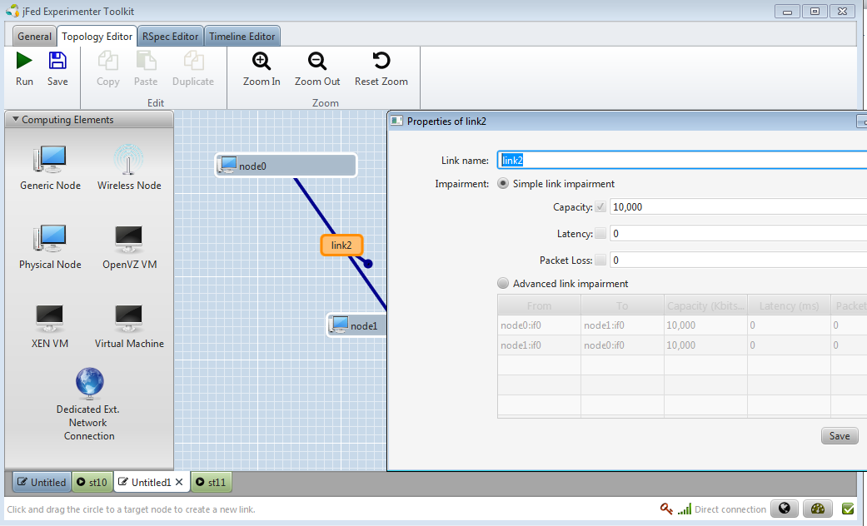
Play with link emulation

