Slide 1

Wireless tutorial

Slide 2
FGRE Wireless Tutorial
Part 1 :
  WiFi experiment @ iMinds w-iLab.t
  Including mobile nodes
  Throughput tests
Part 2 :
  WiMAX tutorial @ UTH Nitos
  Channel quality measurements

Slide 3
Part 1 : WiFi @ w-iLab.t

Slide 4
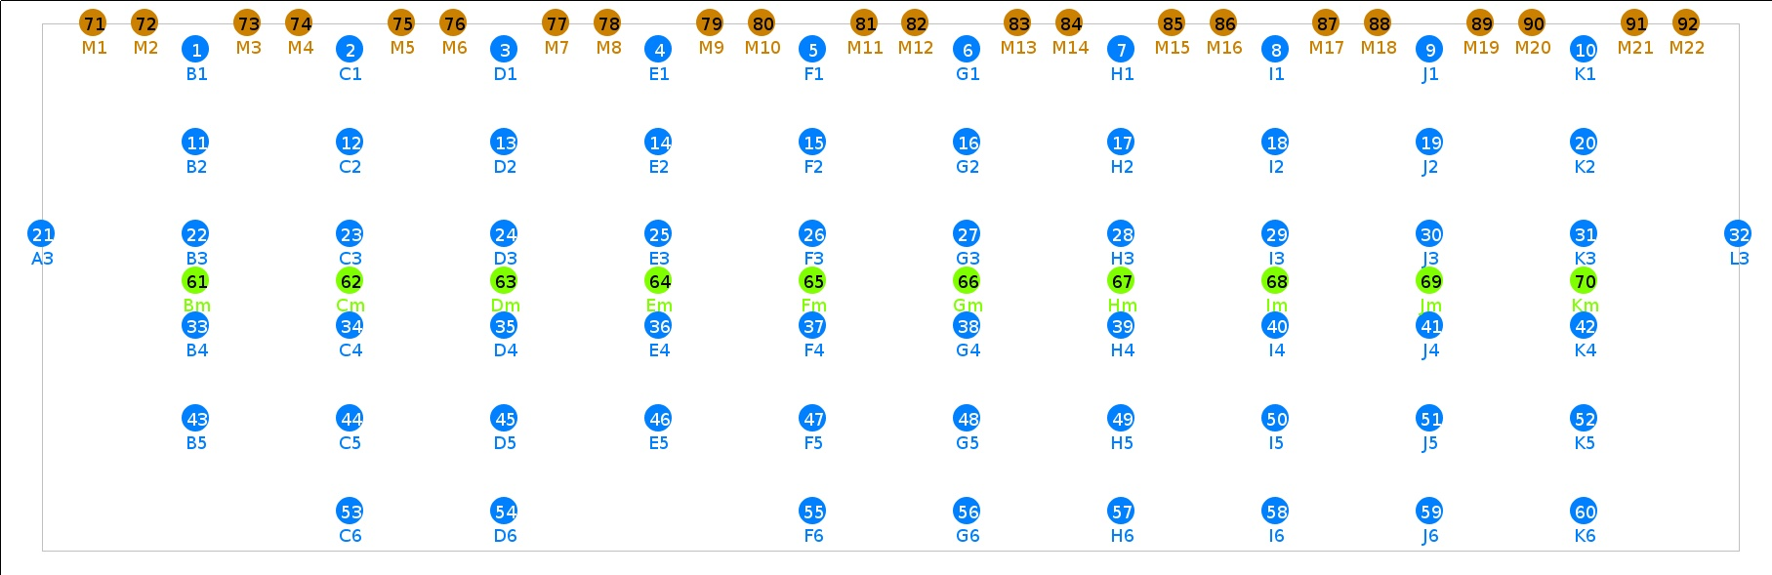
w-iLab.t Zwijnaarde

Slide 5
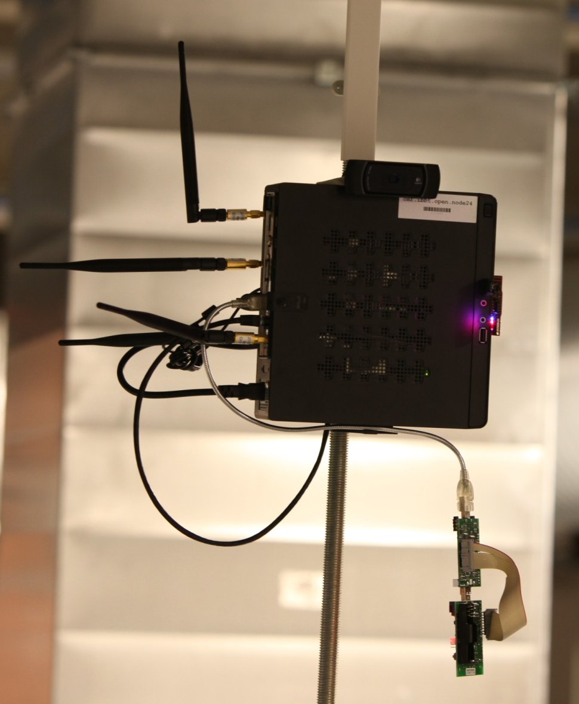
Hardware
Embedded PC (Zotac)
  2x WiFi 802.11 a/b/g/n
  802.15.4 sensor node
  Bluetooth 3.0 EDR

Slide 6
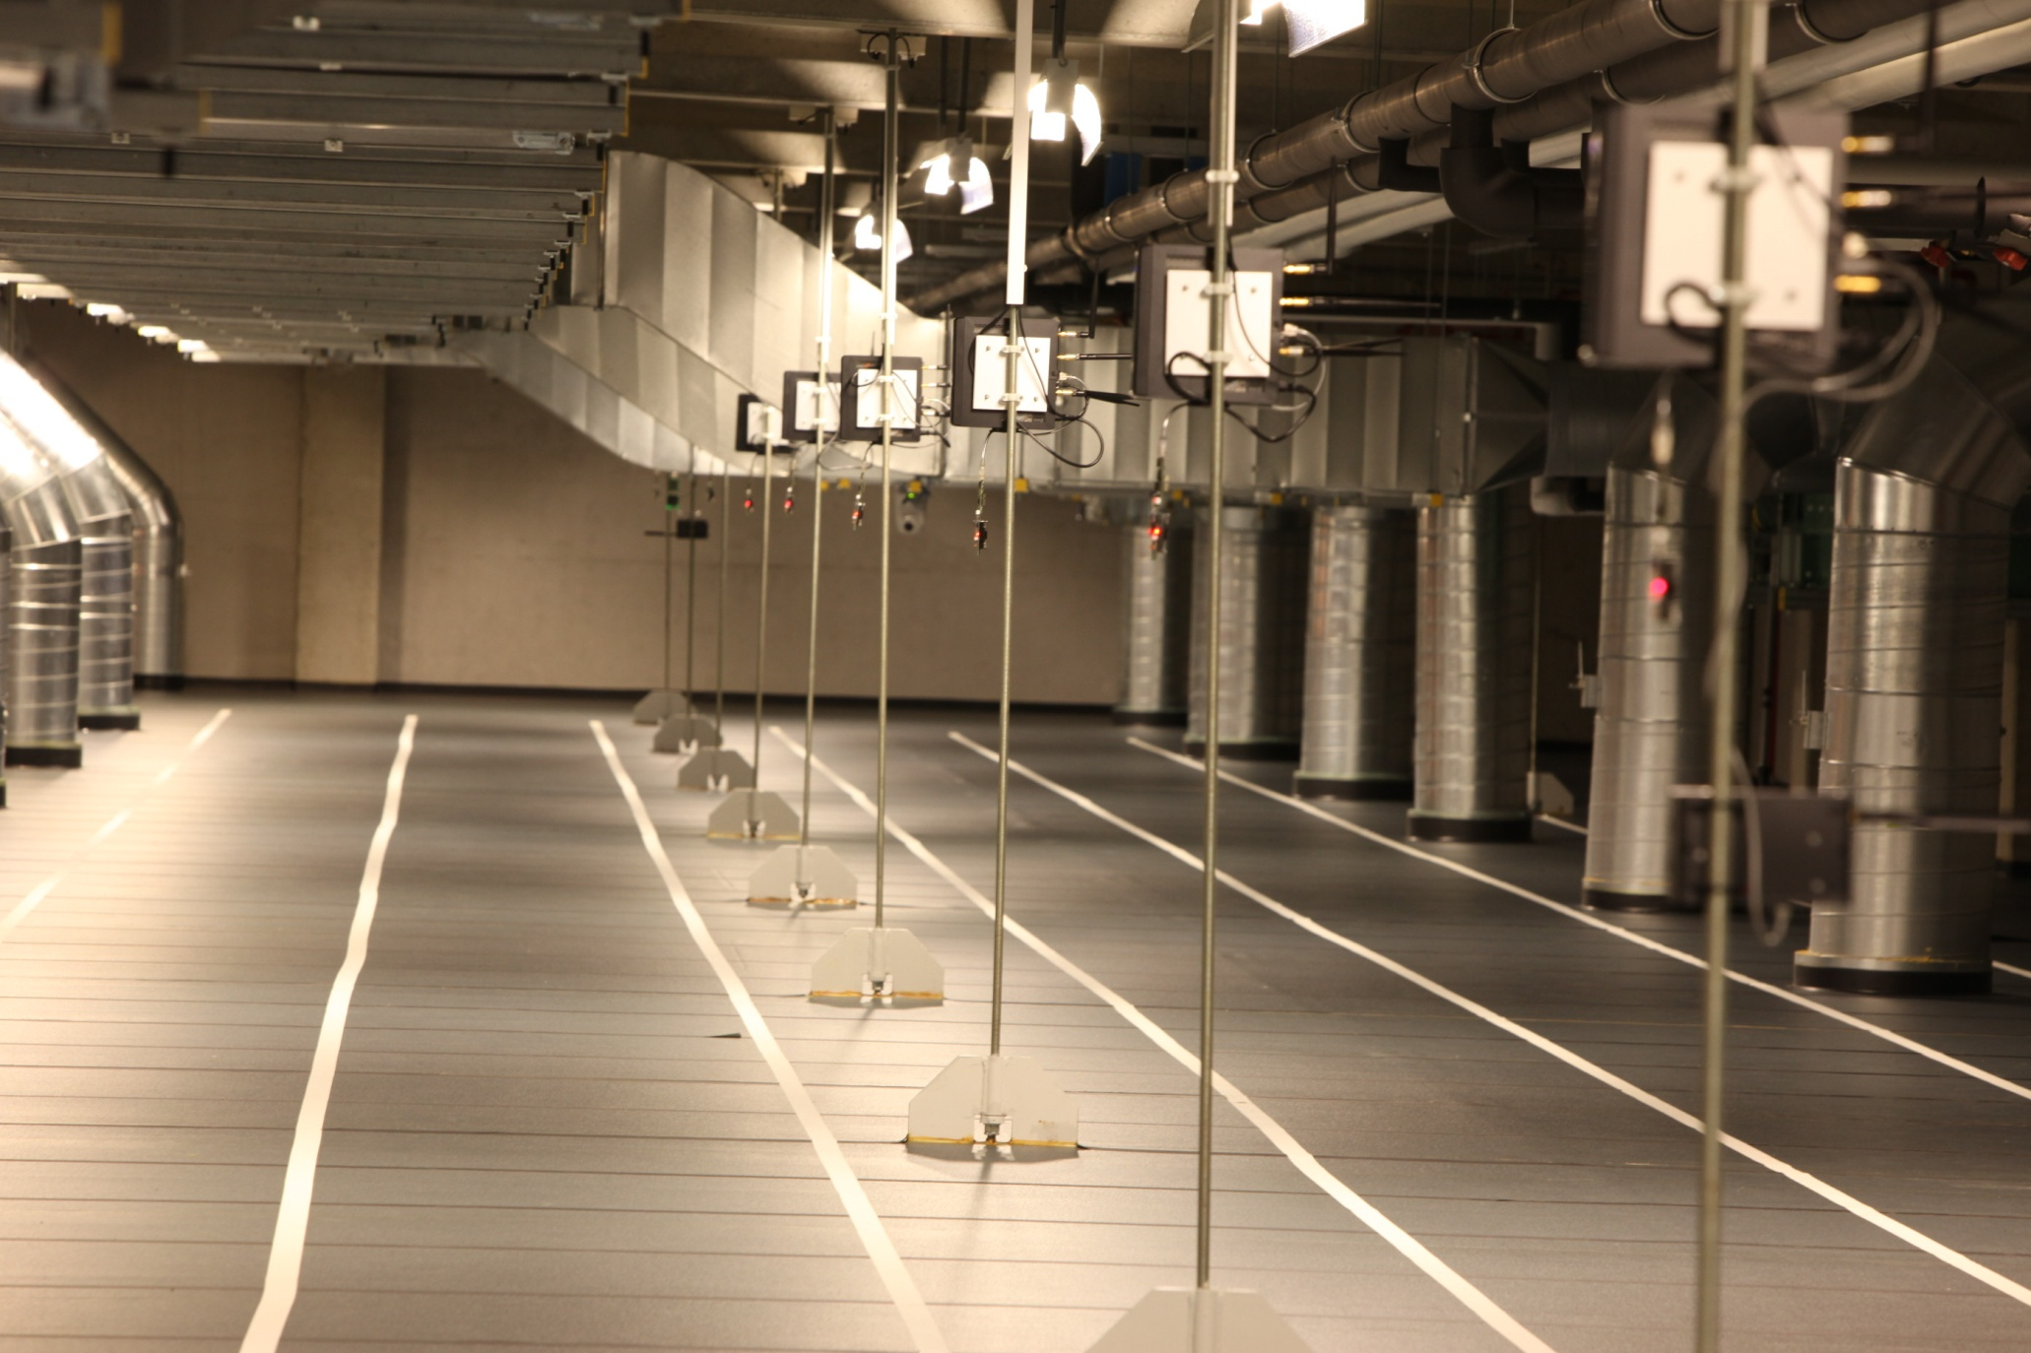

Slide 7
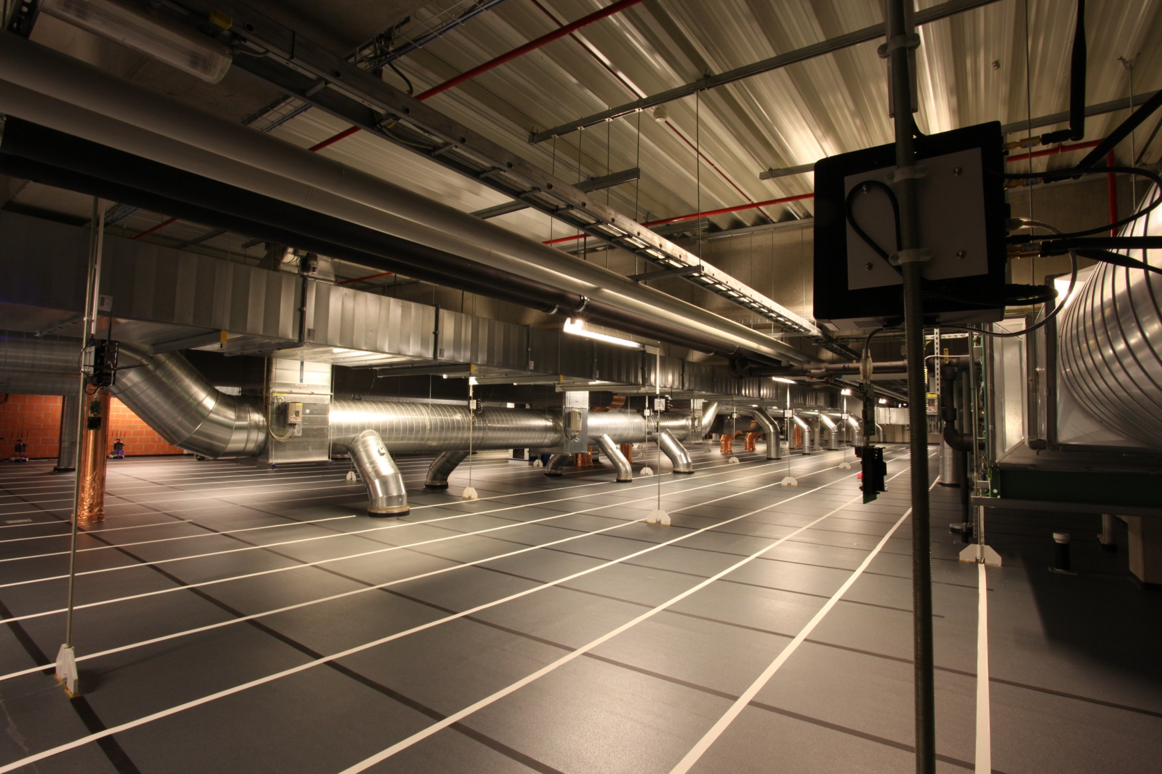

Slide 8
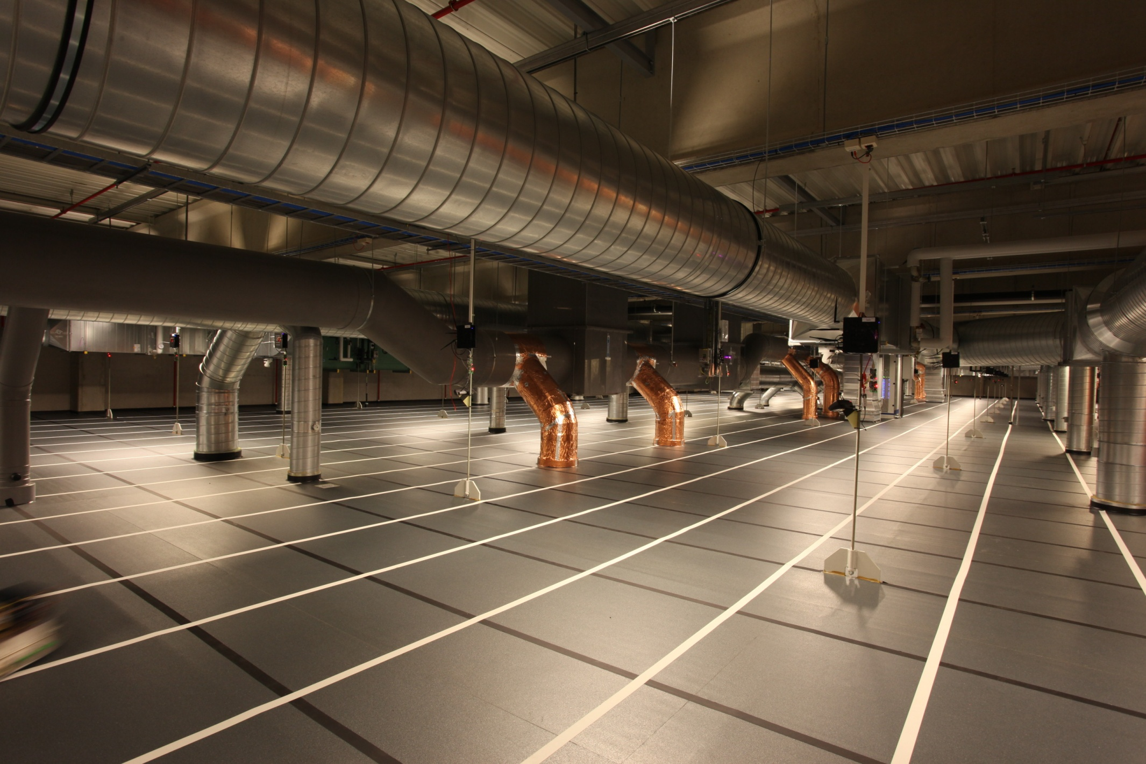

Slide 9
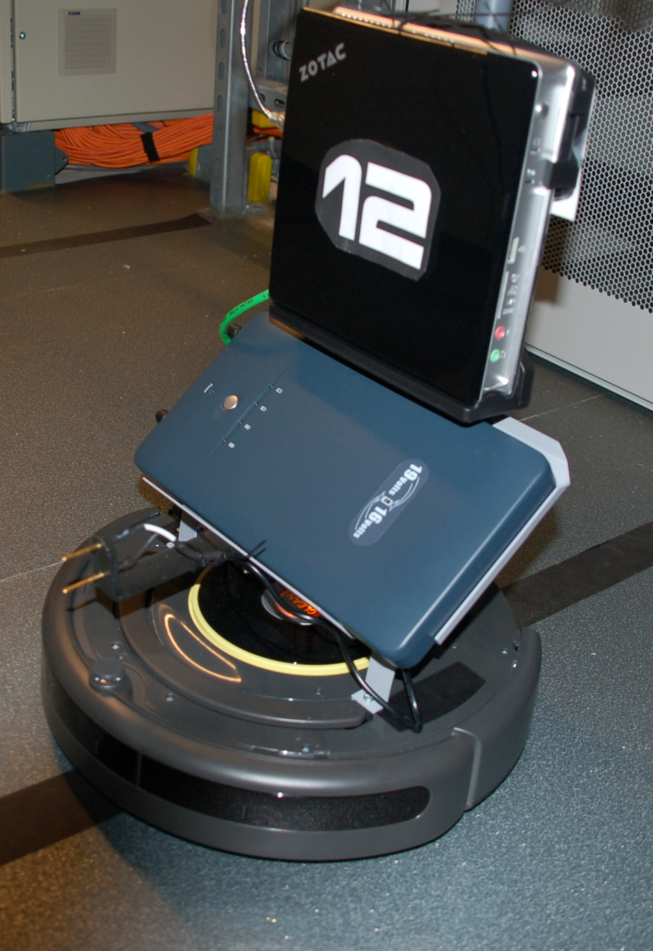
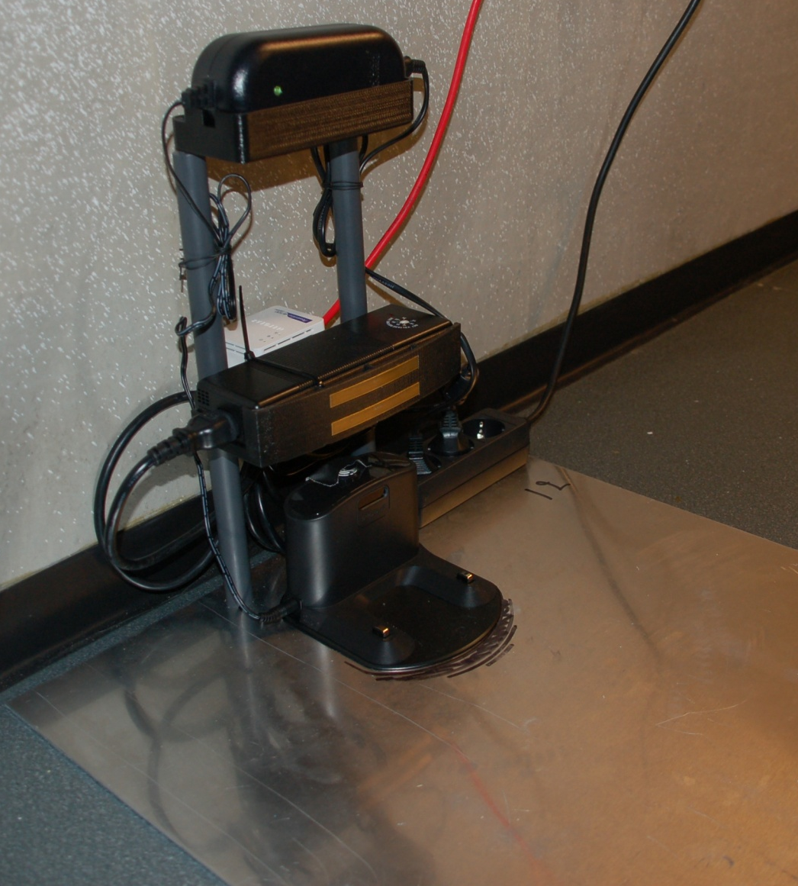

Slide 10
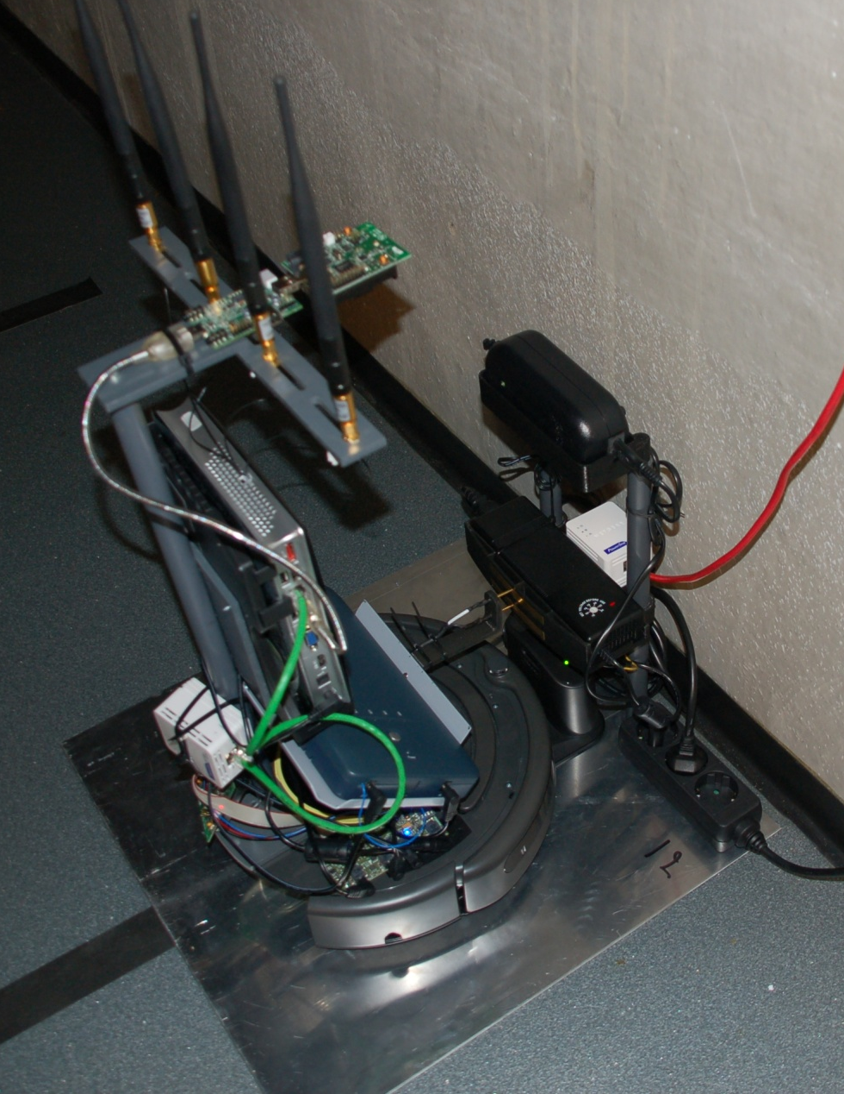
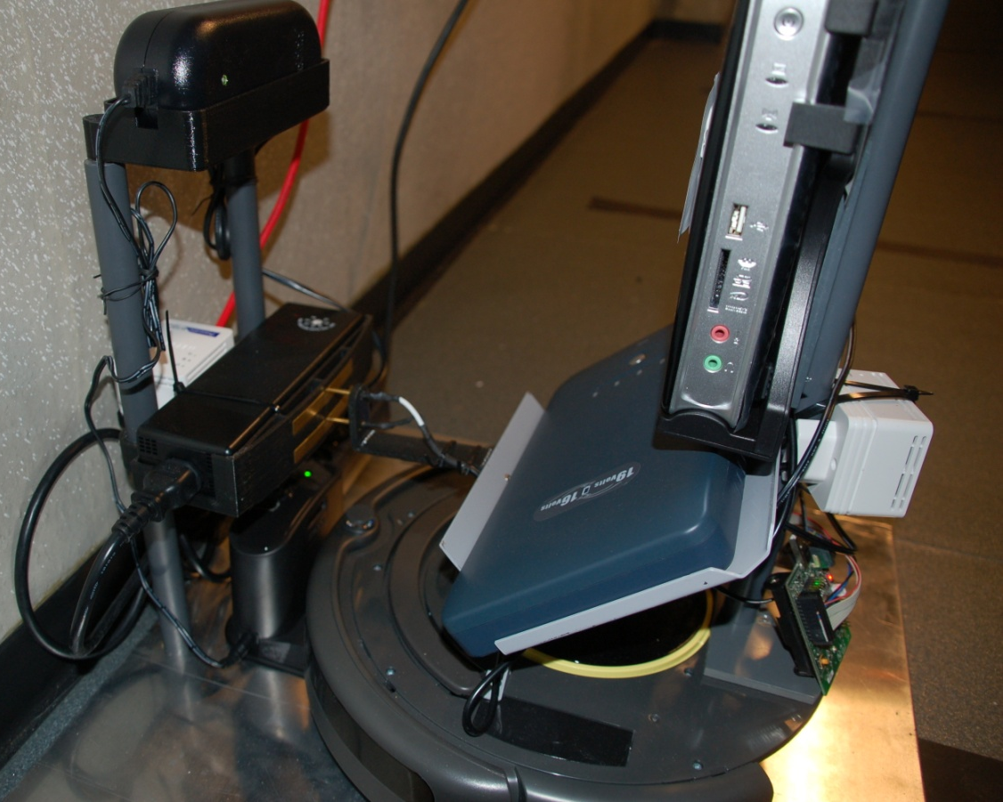

Slide 11
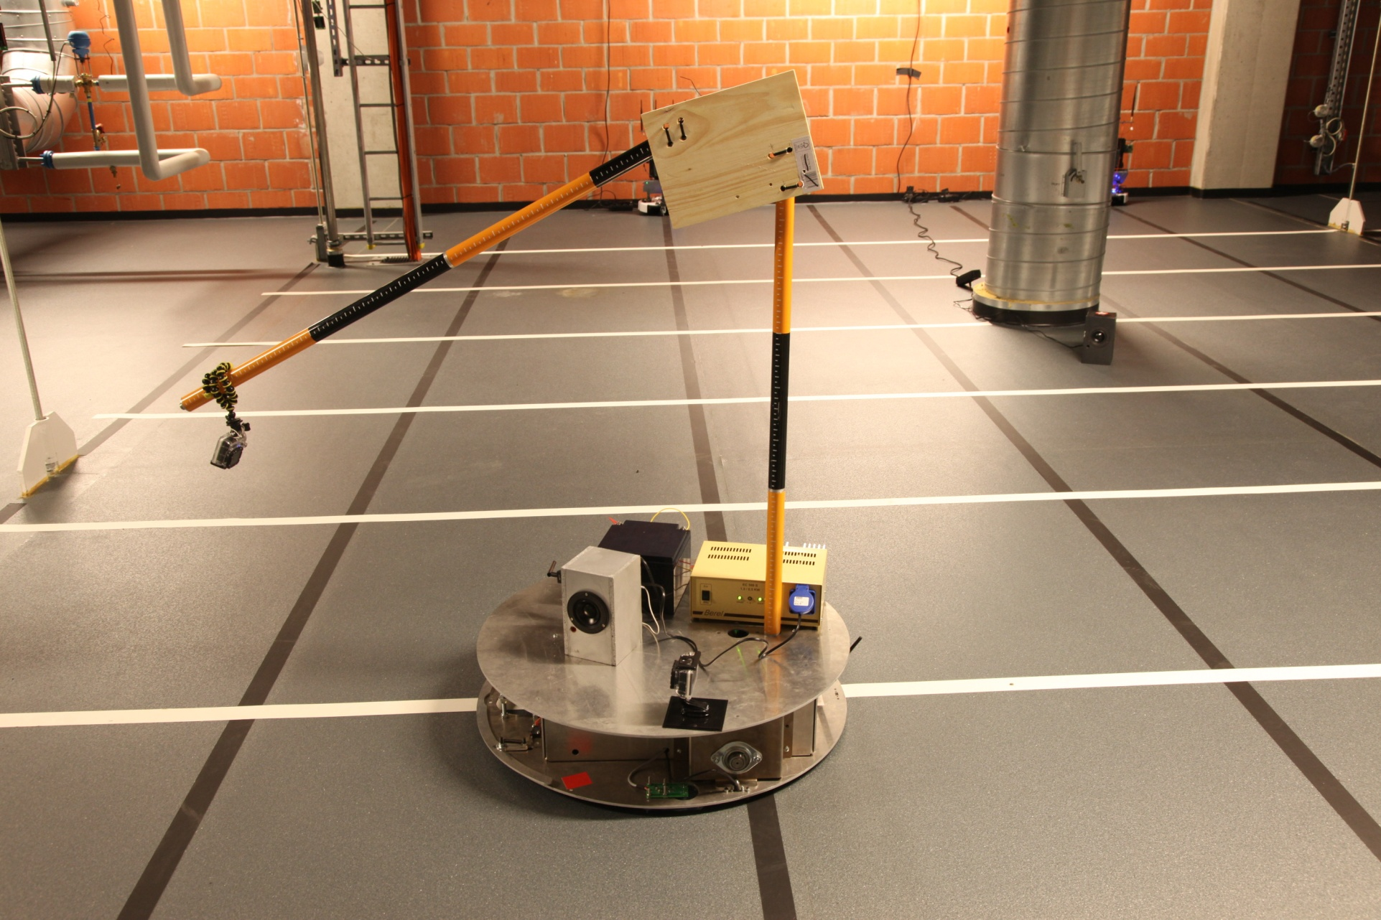
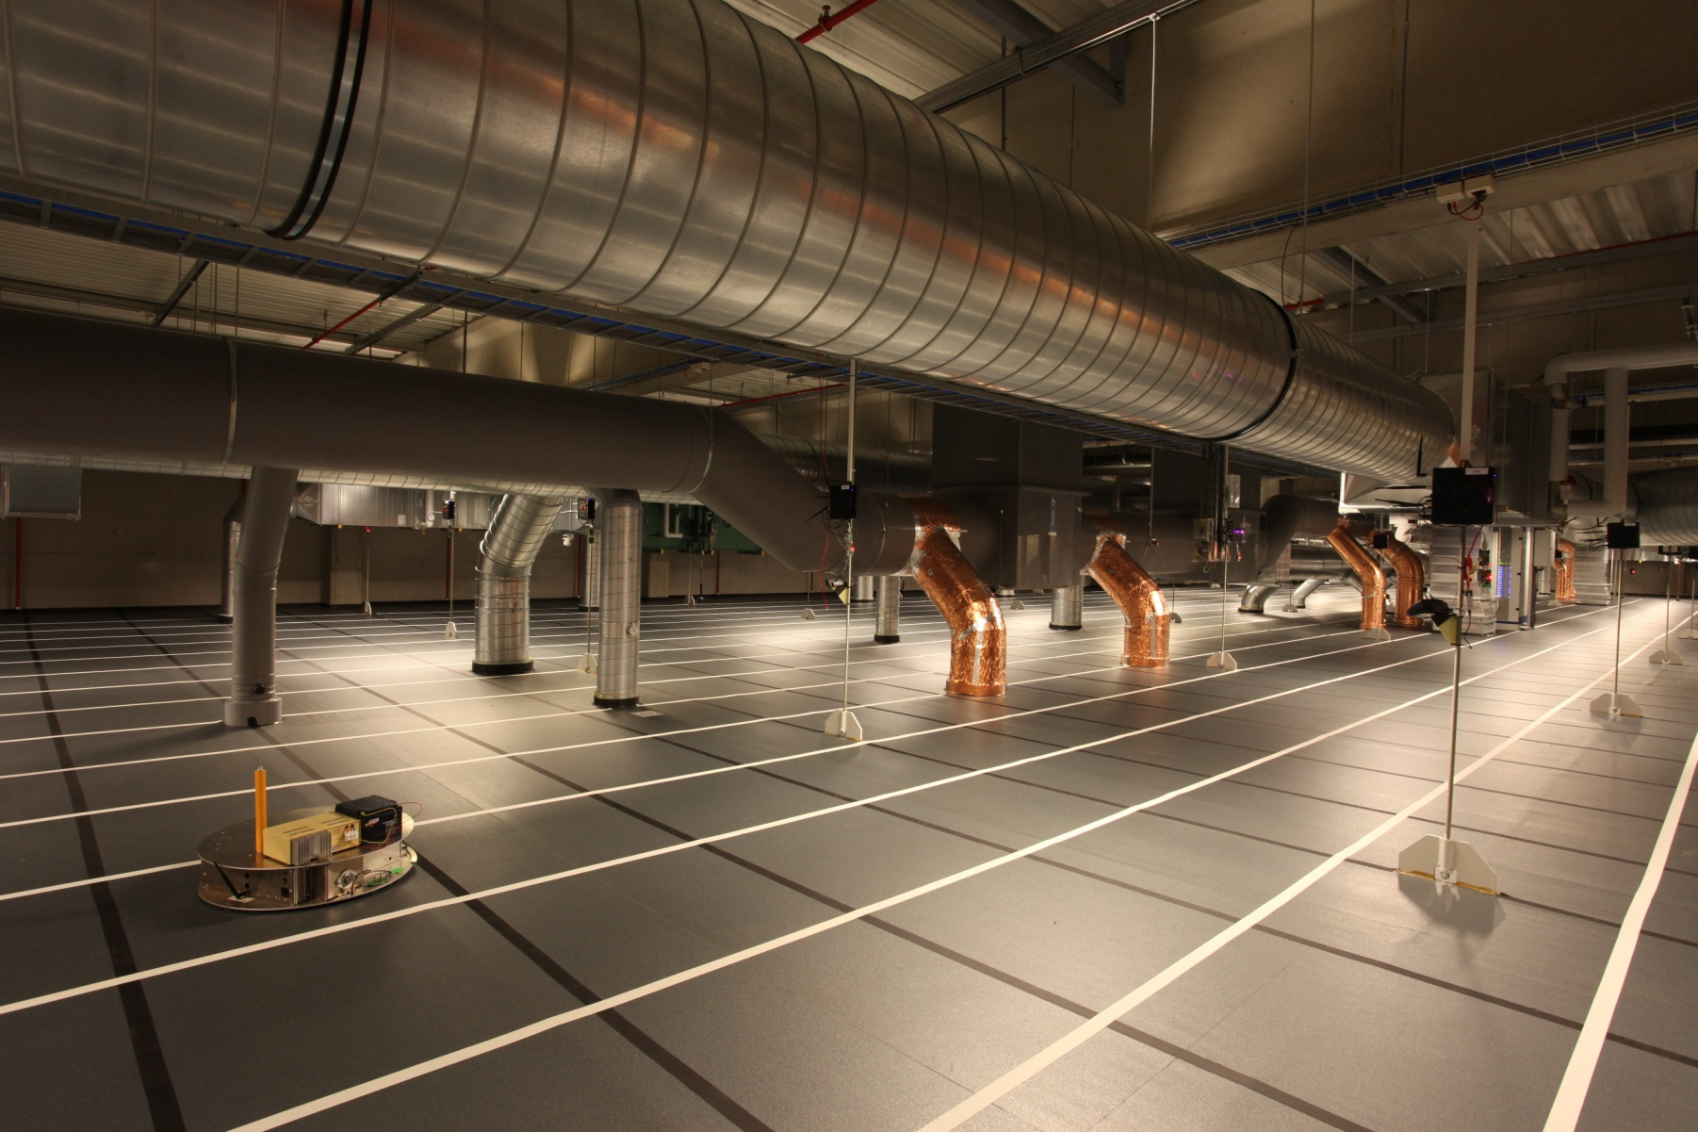
Mobile nodes

Slide 12
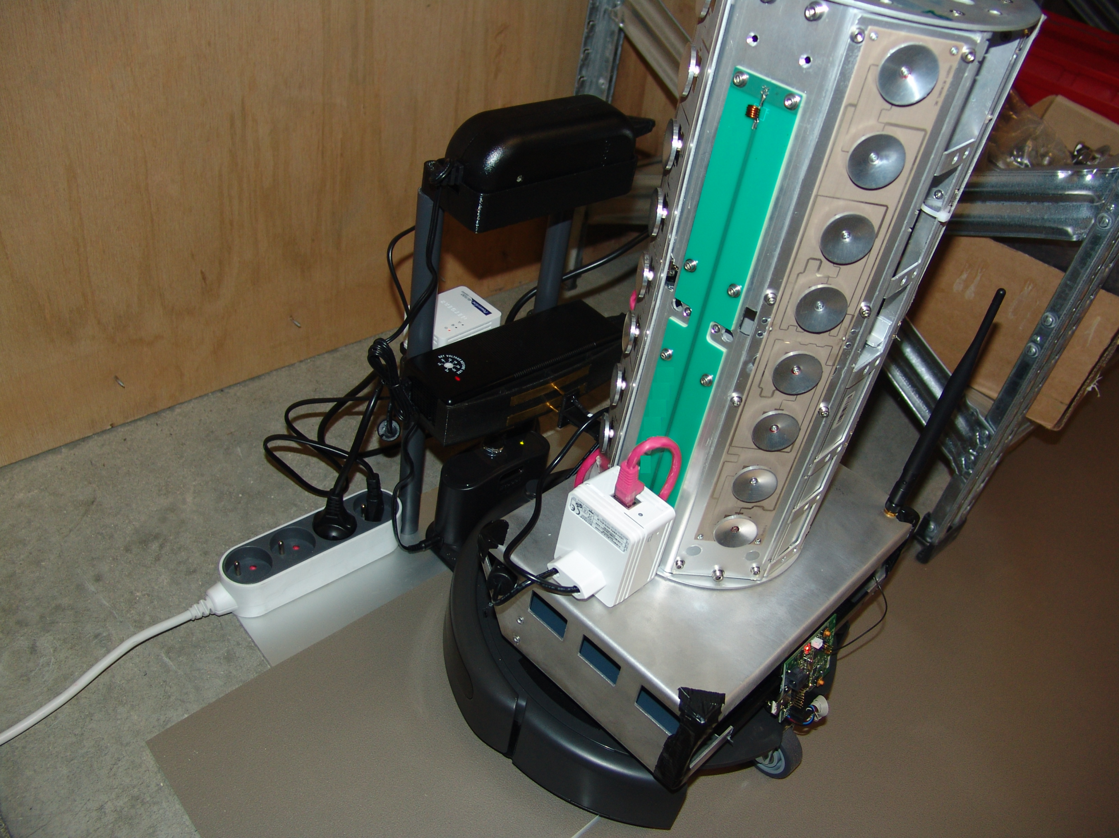

Slide 13
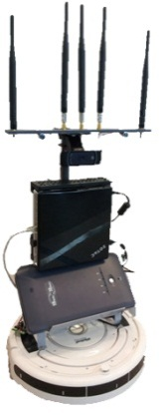
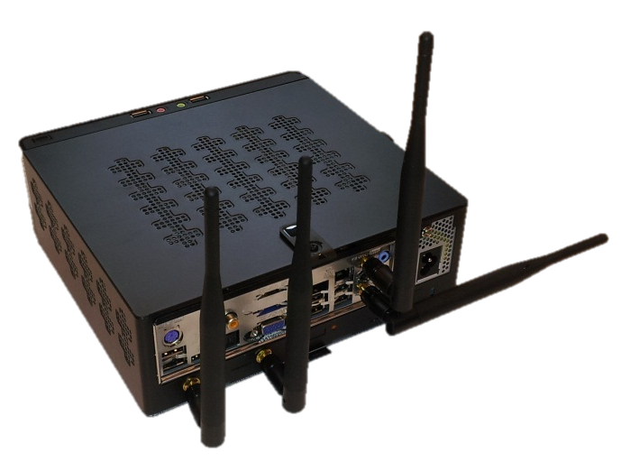
Tutorial
Client
Access point
iPerf server
iPerf client

Slide 14
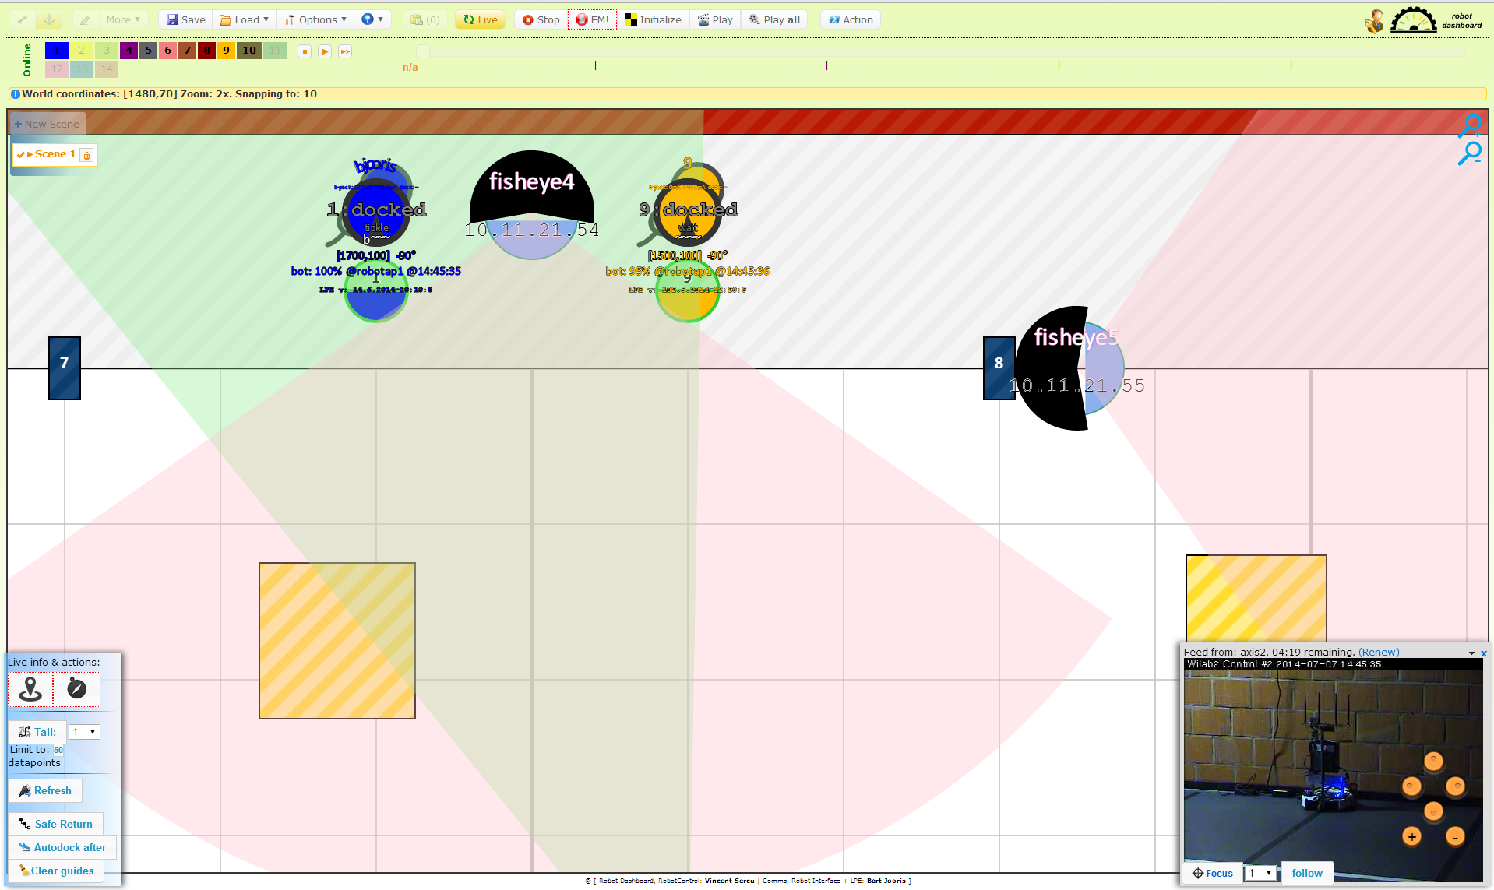
Mobile node control

Slide 15
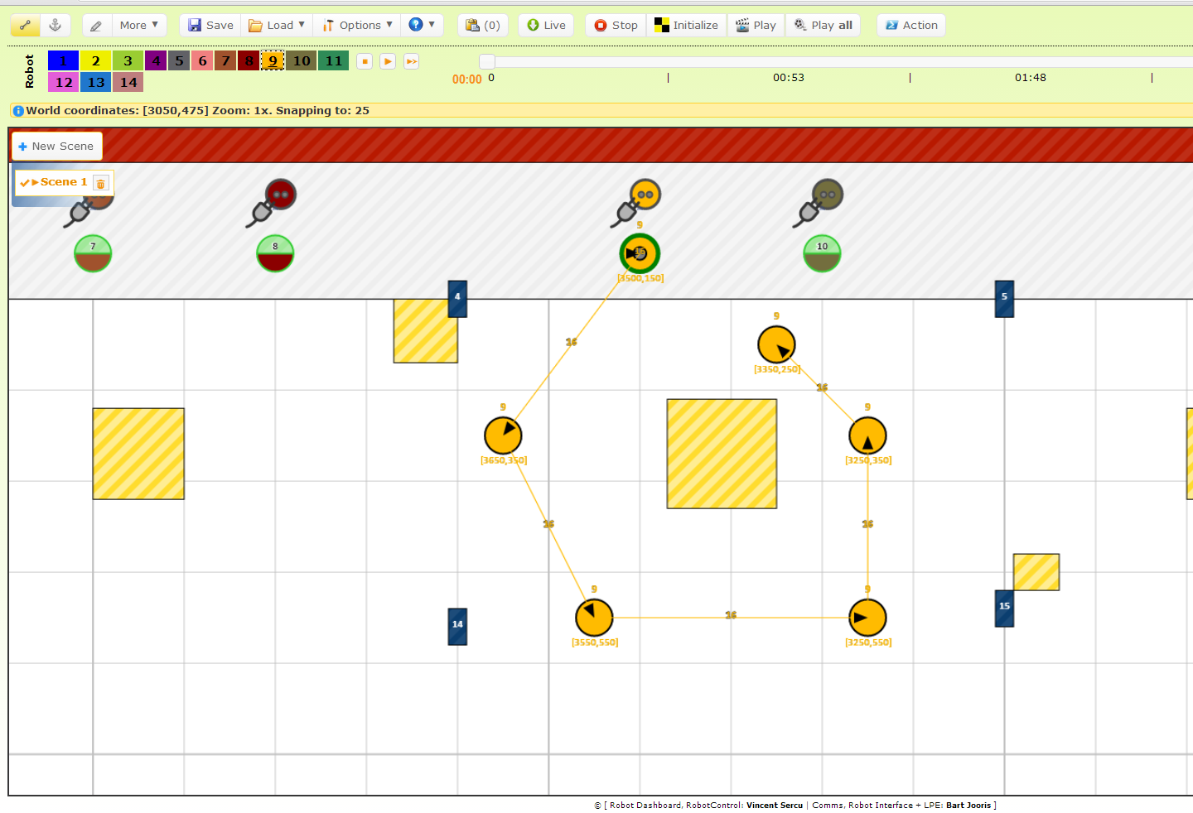

Slide 16
WiMAX @ NITOS
University of Thessaly

Slide 17
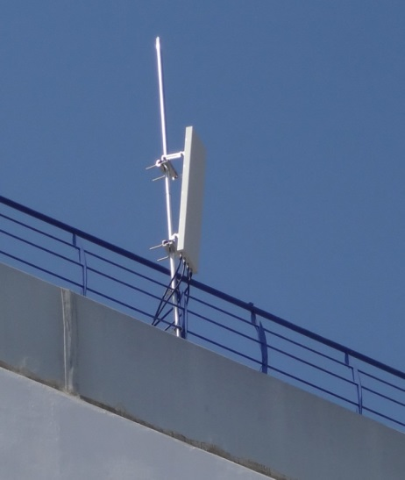
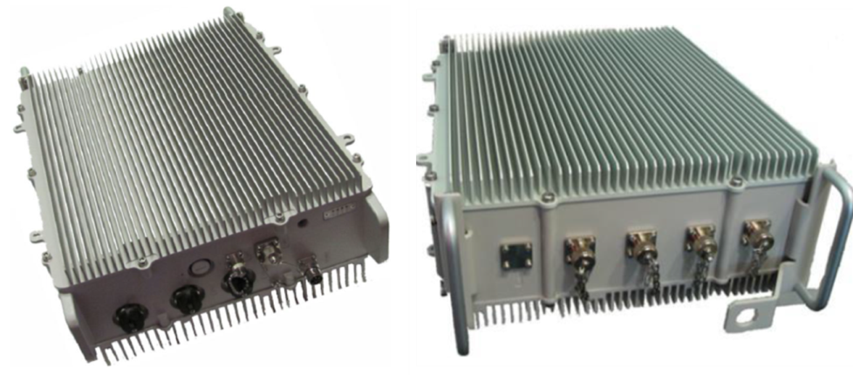
WiMAX Tutorial (UTH)
Goal of this tutorial is for the students to get a hands-on experience on a WiMAX network.
The WiMAX testbed that will be used is NITOS (University of Thessaly – http://nitlab.inf.uth.gr )
The NITOS WiMAX network is provisioned through GENI tools (altered appropriately).
Airspan Base Station Unit and Antenna installation at UTH

Slide 18
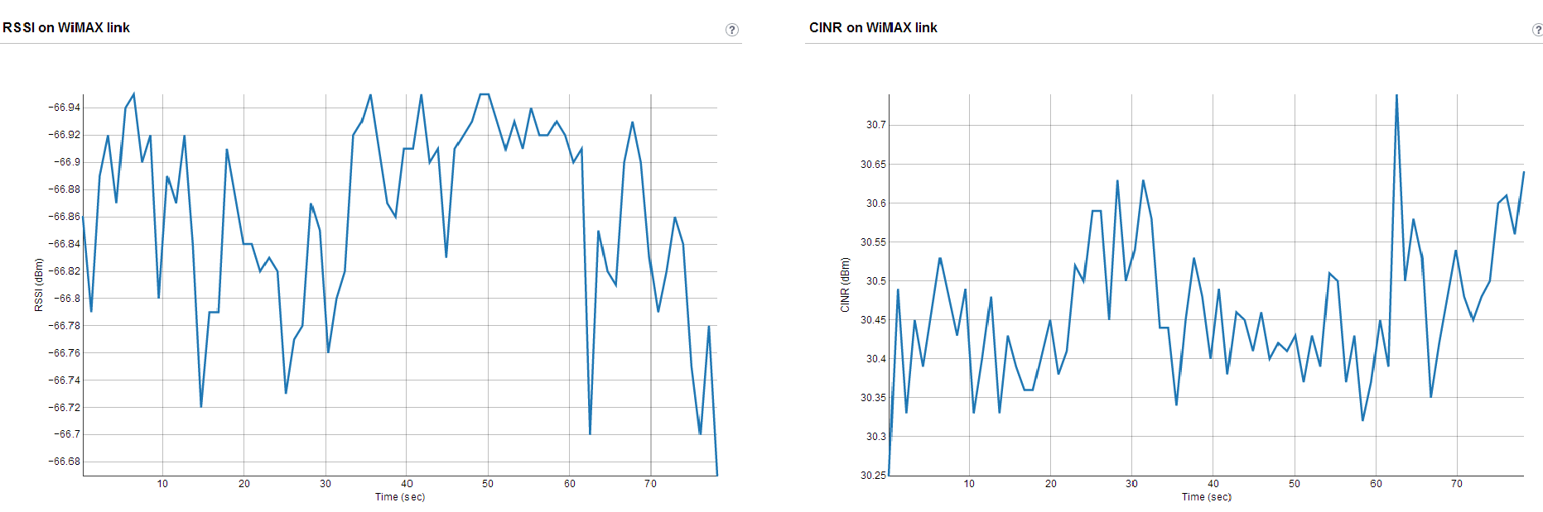
WiMAX Tutorial (UTH)
The students will be asked to do the following tasks:
  Log in to the NITOS testbed.
  Connect a WiMAX client to the WiMAX network.
  Measure the WiMAX channel quality.
  Visualize the results.
  Change WiMAX Base Station parameters.

Slide 19

See you all this afternoon

