Slide 1
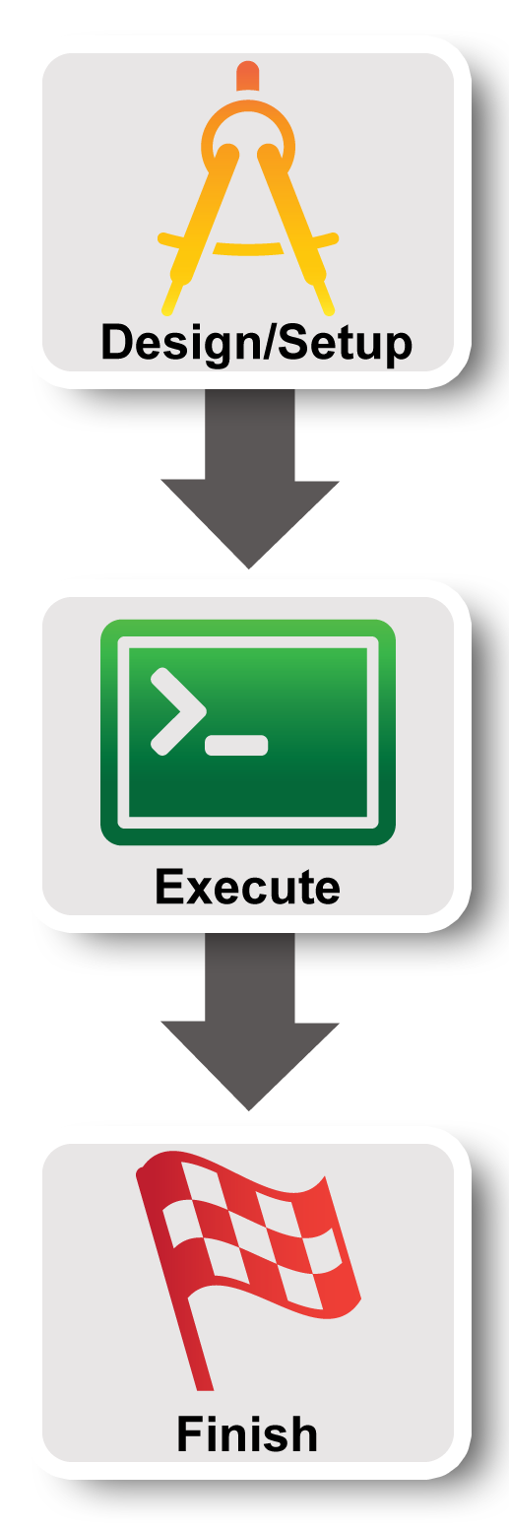
GENI Terminology
GENI Project Office

Slide 2
GENI Terminology
project
slice
experimenter
resource
aggregate
Notes:
Second goal is to understand and use some GENI terminology.

Slide 3
Experimenter
An experimenter is a researcher who uses GENI resources
Different types of experimenters have different roles and permissions:
Advisor vs Grad Student
Teacher vs TA vs Student
Experimenter
Notes:
An experimenter is a researcher who uses GENI resources.
Different experimenters will have different roles in GENI and therefore different permissions.
For example, …..

Slide 4

Creating a GENI account
GENI Portal is at:
  https://portal.geni.net
Instructions for creating an account are:
http://groups.geni.net/geni/wiki/SignMeUp
Notes:
*** If you haven’t already logged in, please do so now. If you are having trouble please raise your hand and someone will come help you. ***
Anyone with an account at a supported identity provider can log in to the GENI portal but they will have no privileges. You must be a member of a project to do anything interesting.

Slide 5


GENI User Authentication
The GENI Portal leverages InCommon for single sign-on authentication
Experimenters from 304 educational and research institutions have InCommon accounts
For many experimenters:
  no new passwords
  familiar login screens
GENI Project Office runs a federated IdP to provide accounts for non-federated organizations.
Notes:
AARON’S EMAIL w/ NUMBERS
The GENI Portal trusts identity providers who are members of the InCommon federation.
Students, faculty and staff will have an account provided by their school (for example, the University of Utah) which they use to access campus resources.
They can then use that account to login to GENI as long as their school is a member of InCommon (with some caveats). **This is exactly like using your Facebook or Google account to access other websites.**
For those experimenters, there are no new passwords. For all others, we are happy to make you an account on the GPO’s identity provider.
Anyone with an account at a supported identity provider (usually your school or employer) can log in, but they will have no privileges
If you don’t have such an account, we will make you an account at the GPO Identity Provider
You must be a member of a project to do anything interesting

Slide 6
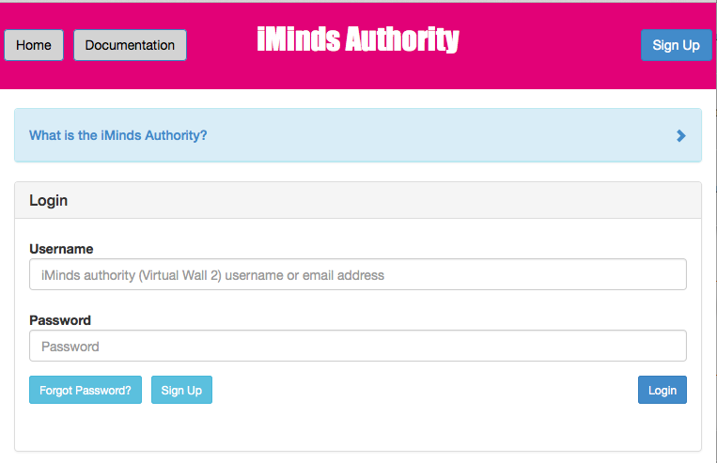
Creating a FIRE account
Notes:
*** If you haven’t already logged in, please do so now. If you are having trouble please raise your hand and someone will come help you. ***
Anyone with an account at a supported identity provider can log in to the GENI portal but they will have no privileges. You must be a member of a project to do anything interesting.

Slide 7
Projects
Project
Slice
Lead
Projects organize research in GENI
Members
  Projects contain both people and their experiments
A project is led by a single responsible individual:
the project lead
Today we will use a
project created for this class
Notes:
Experimenters can perform experiments in the context of a project.
Projects contain both people and their experiments. (Experiments are represented by slices, a term we will define in a few minutes.)
A project must have a single individual who is willing to take responsibility for what happens within the project. This person is called the project lead.
For our purposes today, we will use a project created for this class and the professor will be the project lead.

Slide 8

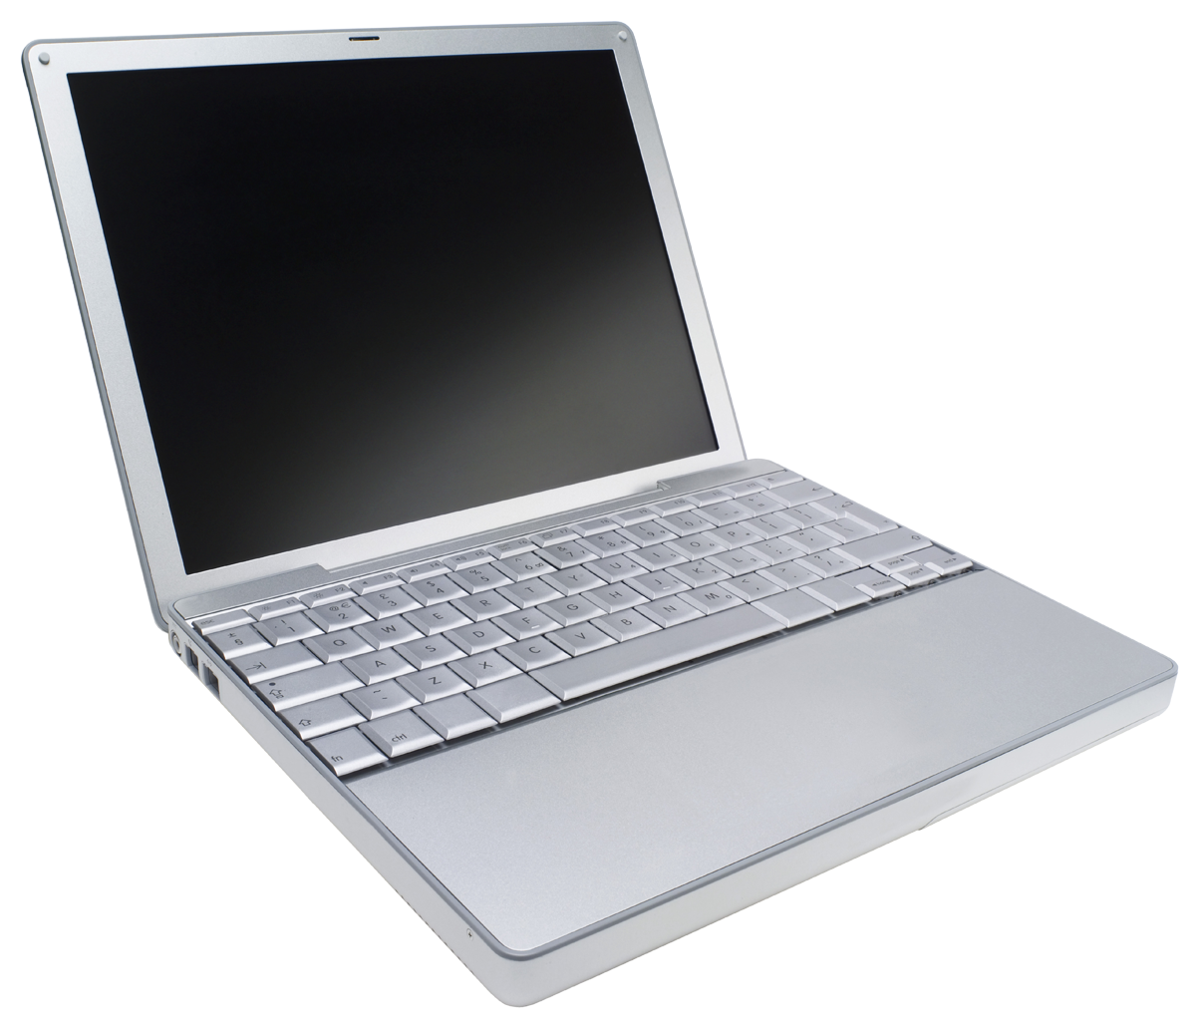
Slice
A slice is a container of resources used in an experiment.
A slice can contain resources from one or more aggregates
A slice is in a single project
A slice has an expiration
Slice names are public, reusable and unique (within a project)
Notes:
A slice is a container for the resources you are using in your experiment.
A slice usually contains resources from multiple aggregates. A slice belongs to a single project and has an expiration. And slice names are unique within a project (as of mid-November 2013).

Slide 9
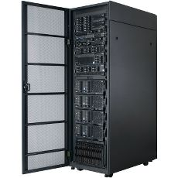
Resource
A resource is a piece of infrastructure
A resource can be real or virtual.
Resource specifications (aka. RSpecs) are used to describe and request resources.
Examples:
Compute: computer vs virtual machine (VM)
Wireline Network: VLAN or OpenFlow
Wireless: WiMAX
Notes:
A resource is something you can reserve -- like a computer or network. Resources can be real or virtualized.
The description of the resources you want to reserve are called a resource specification (abbreviated RSpec).

Slide 10
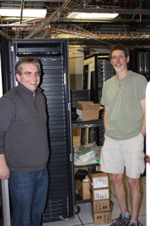
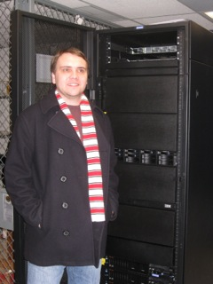


Aggregate
InstaGENI Rack
ExoGENI Rack
An aggregate manages a set of reservable resources
Aggregates include:
  iMinds wall
  GENI racks
  OpenFlow
  WiMAX
Notes:
An aggregate manages a set of available resources.
The GENI racks contains aggregates advertising compute and network resources.

Slide 11
Expiration and renewal
project
slice
resource
resource
resource
(optional)
project
expiration time
resource
expiration time
slice
expiration time
now
slice expiration time ≤ project expiration time
each resource expiration time ≤ slice expiration time
each resource expiration time ≤ aggregate’s max expiration
In general, to extend the lifetime of your resource reservation, you must renew the slice and all resources
Notes:
GENI resources are provided by free on a first-come-first-serve basis. GENI uses a variety of expiration times to ensure resources are returned to the pool of available resources in a timely manner.
To start with, projects have an optional expiration time.
A slice created within that project has a slice expiration time that can not be any later than the project expiration time.
Resources reserved within that slice have an expiration time that can not be later than the slice’s expiration time. Moreover, different resources within the same slice may have distinct expiration times.
In general, to extend the lifetime of your resource reservation, you must renew both the slice and all resources within that slice.

Slide 12

Putting it all together
project
Lead:
Member:
Experimenter
(aka Professor)
Experimenter
(aka Student)
slice
aggregate
resource
resource
Layer 2
Notes:
12
For today’s experiment we are reserving two resources which are VMs.
We are reserving those VMs at a single aggregate.

Slide 13

Using SSH with a public/private keypair
Login to all GENI compute resources using
ssh with a private key
The public key is loaded onto the node when you reserve resources.
You provide the private key when you log into the node.
There are several ways to offer your private key to ssh.
No password!
You should never be prompted for a password to log into a compute node.
If you are, something has always gone wrong.

Slide 14
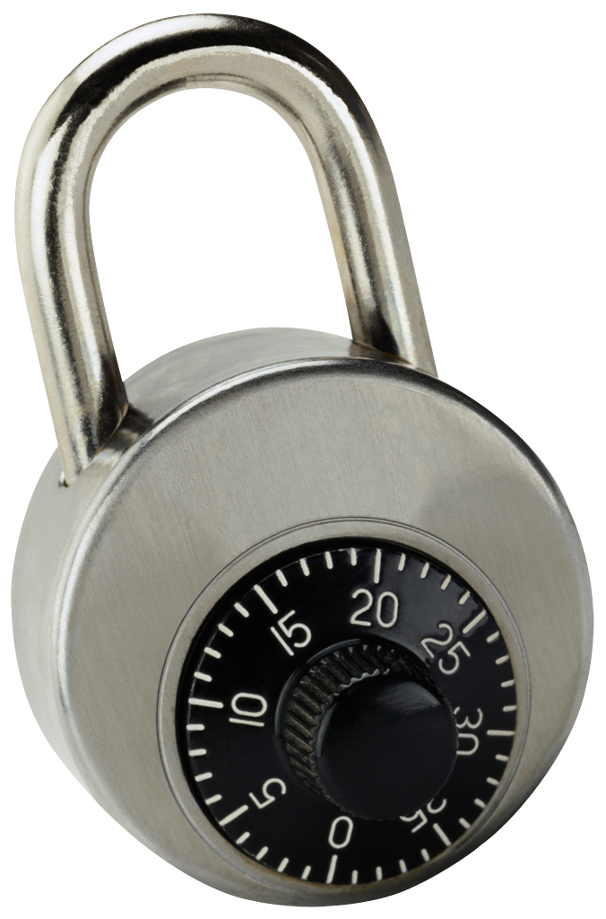
SSH with a password
*nix-based system (Windows behavior may vary)
local> ssh jdoe@remote.edu
jdoe@remote.edu’s password:
########
Welcome to remote!
jdoe@remote> exit
local> ssh jdoe@remote2.edu
jdoe@remote2.edu’s password:
########
ssh
Experimenter
User enters password
once for
each connection to each machine
Hash of password stored on each remote machine

Slide 15

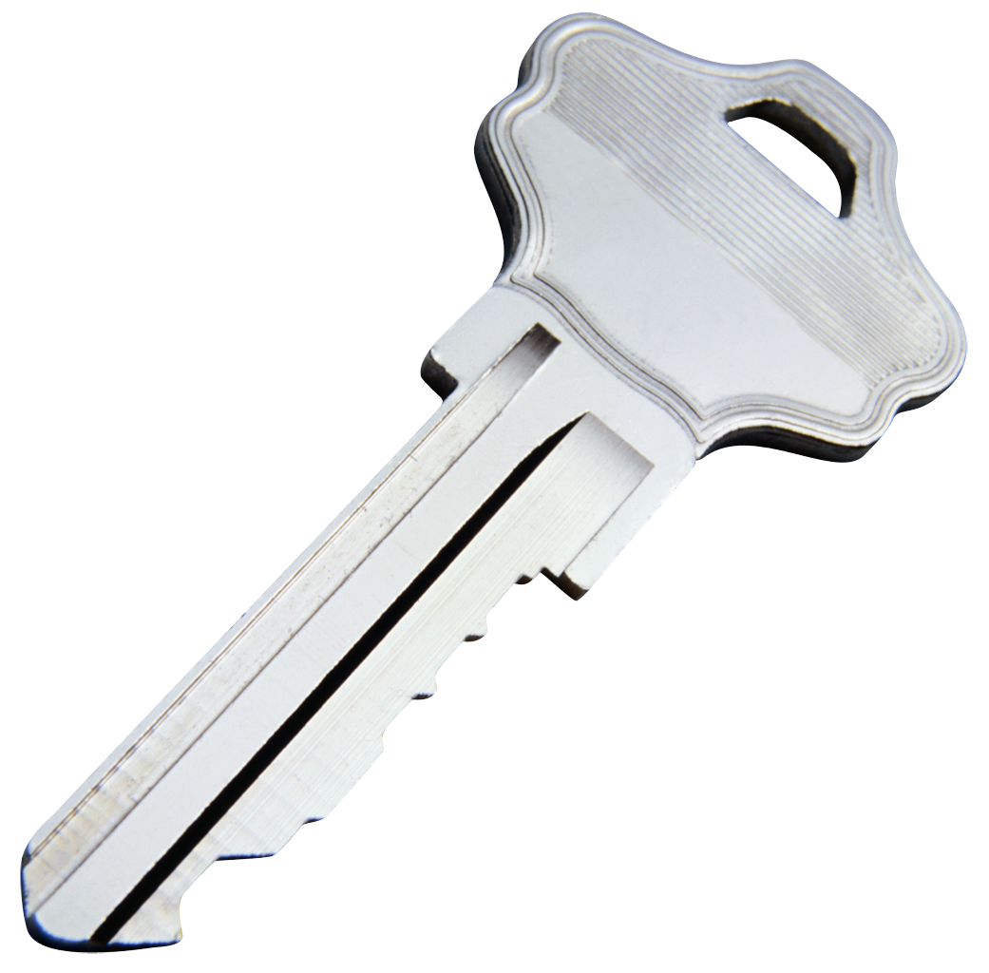
SSH with a private key
*nix-based system (Windows behavior may vary)
local> ssh-add ~/.ssh/id_rsa
Enter passphrase for ~/.ssh/id_rsa:
########
local> ssh jdoe@remote.edu
Welcome to remote!
jdoe@remote> exit
local> ssh jdoe@remote2.edu
Welcome to remote2!
jdoe@remote2> exit
local> ssh jdoe@remote3.edu
Welcome to remote3!
jdoe@remote3> exit
ssh
Experimenter
User enters passphrase to unlock private key
for all connections to
all machine
Private key is stored only on local machine
Public key is stored on each remote machine

