Slide 1

Introduction to OpenFlow
Niky Riga
GENI Project Office

Slide 2
“The current Internet is at an impasse because new architecture cannot be deployed or even adequately evaluated” [PST04]
[PST04]: Overcoming the Internet Impasse through Virtualization, Larry Peterson, Scott Shenker, Jonothan Turner Hotnets 2004
Modified slide from: http://cenic2012.cenic.org/program/slides/CenicOpenFlow-3-9-12-submit.pdf

Slide 3
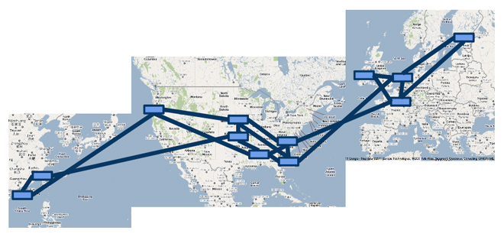
OpenFlow…
Enables innovation in networking
Changes practice of networking
Google’s SDN WAN

Slide 4
OpenFlow basics
How OpenFlow works … (1.0)
What’s new in OpenFlow 1.3
OpenFlow basics

Slide 5
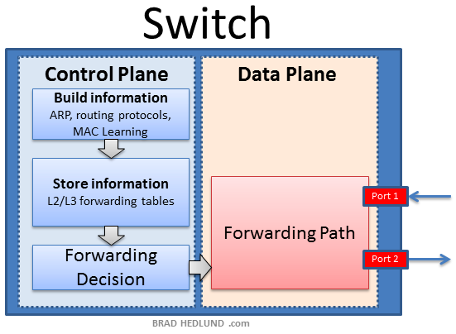
OpenFlow’s basic idea

Slide 6
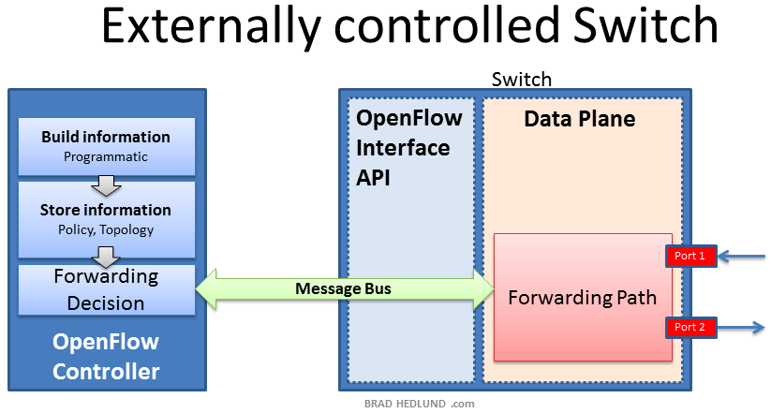
OpenFlow’s basic idea

Slide 7

OpenFlow is an API
Control how packets are forwarded
Implementable on COTS hardware
Make deployed networks programmable
  not just configurable
Makes innovation easier
Modified slide from : http://www.deutsche-telekom-laboratories.de/~robert/GENI-Experimenters-Workshop.ppt

Slide 8
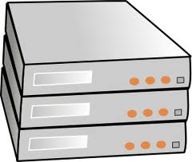
Network Devices
DHCP
access point
router
DNS
proxy
VPN
gateway
firewall
NAT
switch
software
Any network device can be OpenFlow enabled

Slide 9
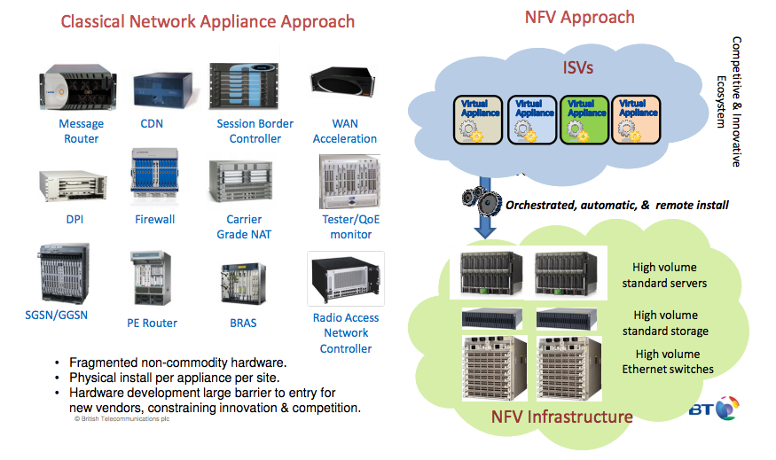
SDN and NFV
Slide from: http://docbox.etsi.org/Workshop/2013/201304_FNTWORKSHOP/S07_NFV/BT_REID.pdf

Slide 10
OpenFlow benefits [1]
External control
  Enables network Apps
  General-purpose computers (Moore’s Law)
  Deeper integration
  Network hardware becomes a commodity
Centralized control
  One place for apps to interact (authentication, auth, etc)
  Simplifies algorithms
  Global Optimization and planning
[1]: OpenFlow: A radical New idea in Networking, Thomas A. Limoncelli CACM 08/12 (Vol 55 No. 8)

Slide 11
Network Types
Campus
  Multiple buildings, heterogeneous IT, groups of users, campus backbone
Enterprise Data Centers
  Security, various sizes, storage, WAN optimizations
Data Centers – Clouds
  Multi-tenant, virutalization, disaster recovery, VM mobility
WAN
  Diversity, multiple domains/carriers/users

Slide 12
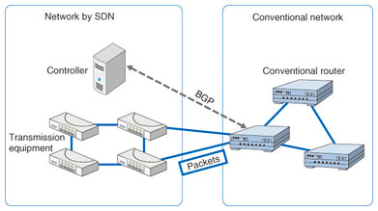
Deployment Stories
Google global private WAN [1]
  Connects dozens of datacenters worldwide with a long-term average of 70% utilization over all links
Stanford Campus deployment
  Part of Stanford campus
  migrated to OpenFlow
NTT’s BGP Free Edge
Internet 2 - AL2S
Can build Layer 2 circuits between
any Internet 2 end-points
https://www.ntt-review.jp/archive/ntttechnical.php?contents=ntr201310fa3.html
[1] B4: Experience with a Globally-Deployed Software Defined WAN, SIGCOMM’13, Jain et al.

Slide 13


GENI and OpenFlow deployment
Key GENI concept: slices & deep programmability
  Internet: open innovation in application programs
  GENI: open innovation deep into the network
Good old Internet
Slice 0
Slice 1
Slice 1
OpenFlow switches one of the ways GENI is providing deep programmability
Slice 2
Slice 3
Slice 4

Slide 14
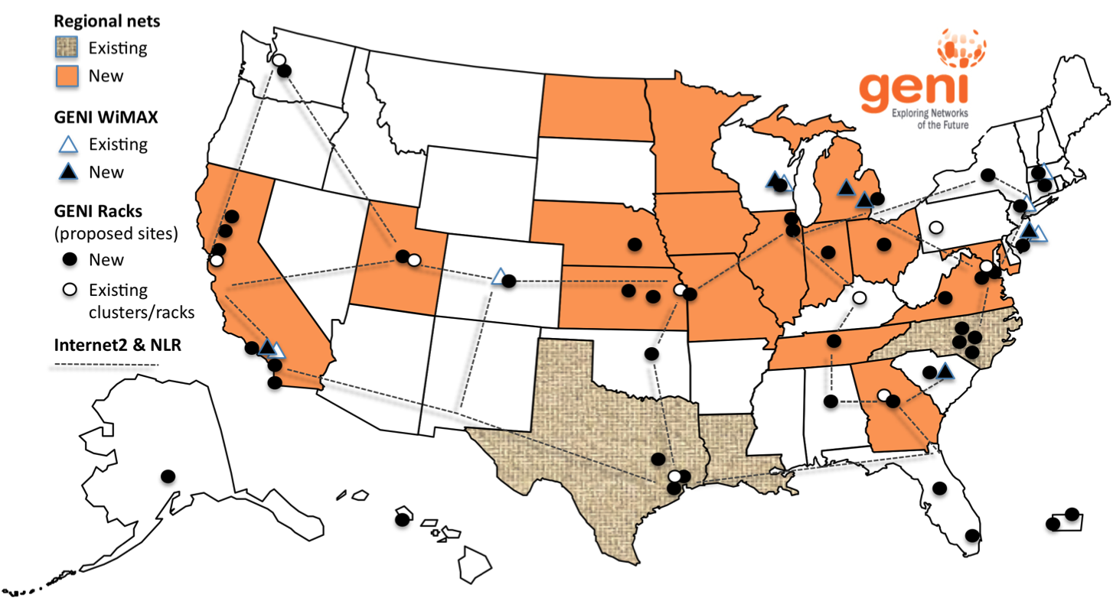
GENI OpenFlow Deployment
OpenFlow-enabled hardware switch at:
  Each GENI Rack
  Backbone and regional networks

Slide 15
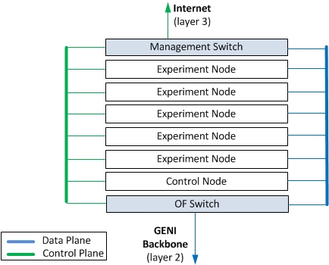
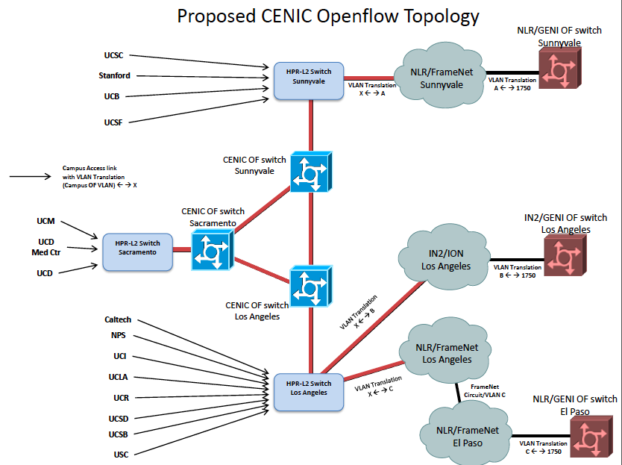


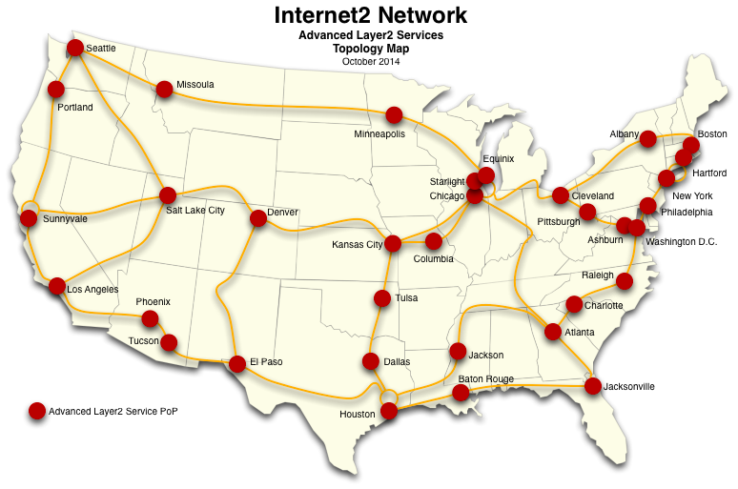
OpenFlow Switches
GENI Rack
GENI-enabled regionals
e.g. CENIC
Internet2 AL2S

Slide 16



GENI OpenFlow Experiments
VDC: real-time load-balancing functionality deep into the network to improve QoE
Prasad Calyam, Missouri
MobilityFirst: A new architecture for the Internet designed for emerging mobile/wireless service requirements at scale
Dipankar (Ray) Raychaudhuri, Rutgers, leads MobilityFirst
NowCast SDX: Improve in-time weather
forecasting using Software Defined eXchanges
Mike Zink
Umass Amherst

Slide 17
OpenFlow basics
What’s new in OpenFlow 1.3
How OpenFlow works … (1.0)

Slide 18
OpenFlow versions
(‘11) Open Networking Foundation (ONF) formed to shepherd standards
(‘12/’13) OpenFlow 1.3.x
Complex &
support in progress
(Dec ’09) OpenFlow 1.0.0
Simple & widely supported
(Feb ‘11) OpenFlow 1.1.0
Not implemented by HW vendors
(Oct ‘13) OpenFlow 1.4
(Nov‘13) OpenFlow 1.0.2
(Dec ‘11) OpenFlow 1.2
First ONF standard

Slide 19
OpenFlow controllers
Open source controller frameworks
  NoX – C++
  PoX - Python
  OpenDaylight - Java
  FloodLight - Java
  Trema – C / Ruby
  Maestro - Java
  Ryu - Python
Production controllers
  Mostly customized solutions based on Open Source frameworks
  ProgrammableFlow - NEC

Slide 20
OpenFlow
Any Host
The controller is responsible for populating forwarding table of the switch
In a table miss the switch asks the controller
OpenFlow Controller
OpenFlow Protocol (SSL/TCP)
Switch
Control Path
OpenFlow
Data Path (Hardware)
Modified slide from : http://www.deutsche-telekom-laboratories.de/~robert/GENI-Experimenters-Workshop.ppt

Slide 21

OpenFlow in action
Any Host
Host1 sends a packet
If there are no rules about handling this packet
  Forward packet to the controller
  Controller installs a flow
Subsequent packets do not go through the controller
OpenFlow Controller
OpenFlow Protocol (SSL/TCP)
Switch
Control Path
OpenFlow
Data Path (Hardware)
host1
host2
Modified slide from : http://www.deutsche-telekom-laboratories.de/~robert/GENI-Experimenters-Workshop.ppt

Slide 22
OpenFlow Basics (1.0)
Rule
Action
Stats
Packet + byte counters
Forward packet to port(s)
Encapsulate and forward to controller
Drop packet
Send to normal processing pipeline
Modify Fields
Switch
Port
VLAN
ID
VLAN
PCP
MAC
src
MAC
dst
Eth
type
IP
Src
IP
Dst
IP
Prot
IP
ToS
TCP
sport
TCP
dport
+ mask what fields to match
slide from : http://www.deutsche-telekom-laboratories.de/~robert/GENI-Experimenters-Workshop.ppt
Notes:
Now I’ll describe the API that tries to meet these goals.
22

Slide 23
Use Flow Mods
Going through the controller on every packet is inefficient
Installing Flows either proactively or reactively is the right thing to do
A Flow Mod consists of :
  A match on any of the 12 supported fields
  A rule about what to do matched packets
  Timeouts about the rules:
    Hard timeouts
    Idle timeouts
  The packet id in reactive controllers
  Priority of the rule

Slide 24
OpenFlow common PitFalls
Controller is responsible for all traffic, not just your application!
  ARPs, DHCP, LLDP
Reactive controllers
  Cause additional latency on some packets
  UDP – many packets queued to your controller by time flow is set up
Performance in hardware switches
  Not all actions are supported in hardware
No STP to prevent broadcast storms

Slide 25
OpenFlow datapaths
OpenFlow enabled devices are usually referred to as datapaths with a unique dpid
It is not necessary that 1 physical device corresponds to 1 dpid
Different OpenFlow modes
  switches in pure OF mode are acting as one datapath
  Hybrid VLAN switches are one datapath per VLAN
  Hybrid port switches are two datapaths (one OF and one non-OF)
Any Host
OpenFlow Controller
OpenFlow Protocol
Switch
Control Path
OpenFlow
Data Path (Hardware)
Each Datapath can point to only one controller at a time!

Slide 26
Multiplexing Controllers
Only one controller per datapath
FlowVisor, FSFW are proxy controllers that can support multiple controllers
FlowSpace describes packet flows :
  Layer 1: Incoming port on switch
  Layer 2: Ethernet src/dst addr, type, vlanid, vlanpcp
  Layer 3: IP src/dst addr, protocol, ToS
  Layer 4: TCP/UDP src/dst port
Any Host
Any Host
OpenFlow Controller
OpenFlow Controller
OpenFlow Protocol (SSL/TCP)
Any Host
FlowVisor
OpenFlow Protocol (SSL/TCP)
Switch
Control Path
OpenFlow
Data Path (Hardware)

Slide 27
FOAM
An OpenFlow Aggregate Manager
It’s a GENI compliant reservation service
  Helps experimenters reserve flowspace in the FlowVisor
Speaks AM API v1 and AM API v2
RSpecs GENI v3, OpenFlow v3 extension

Slide 28
Sharing of OpenFlow resources
In GENI:
  Slice by VLAN for exclusive VLANs
  Slice by IP subnet and/or eth_type for shared VLANs
In FIRE:
On iMinds testbed
  Slice by inport
On OFELIA testbed
  Slice by VLAN

Slide 29
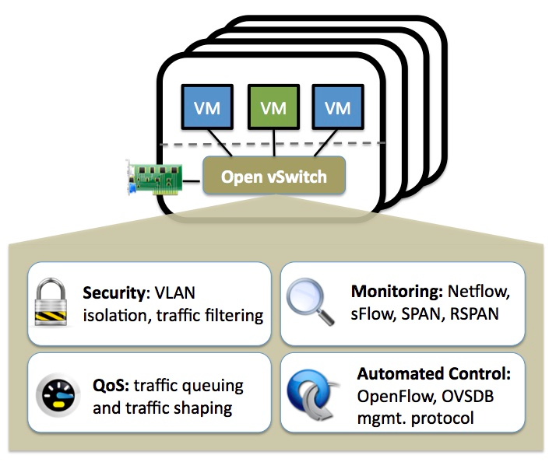
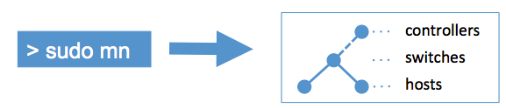
OpenFlow Experiments
Debugging OpenFlow experiments is hard:
  Network configuration debugging requires coordination
  Many networking elements in play
  No console access to the switch
Before deploying your OpenFlow experiment test your controller.
http://mininet.github.com/
http://openvswitch.org/

Slide 30
OpenFlow basics
How OpenFlow works … (1.0)
What’s new in OpenFlow 1.3

Slide 31
Why OpenFlow 1.3?
OF 1.0 primary complaint = too rigid
OF 1.3 gains*
  Greater match and action support
  Instructions add flexibility and capability
  Groups facilitate advanced actions
  Meters provide advanced counters
  Per-table features
  Custom table-miss behavior
  …and more!
* OpenFlow 1.1 and 1.2 introduced some of the features we will discuss. However, due to the relative lack in adoption of OpenFlow 1.1 and 1.2, we will consider such features as OpenFlow 1.3 features.
slide provided by Ryan Izard

Slide 32
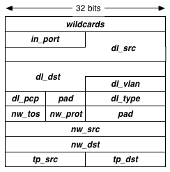
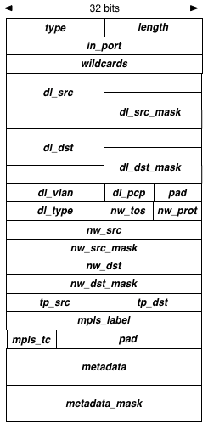
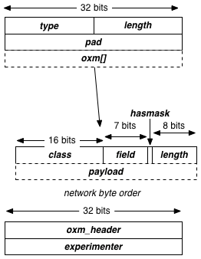
OpenFlow eXtensible Match - OXM
OpenFlow 1.0
OpenFlow 1.1
OpenFlow 1.2+
http://flowgrammable.org/sdn/openflow/message-layer/
  Variable-length list of matches, in any order in contrast to rigid match structure of OF 1.0/1.1
slide provided by Ryan Izard

Slide 33
OpenFlow 1.3 Matches
Increased match support w/OXM
  Ingress port
  Ethernet
  VLAN
  IPv4
  TCP
  UDP
  ARP
  MPLS
  PBB
  ICMPv4
  ICMPv6
  IPv6
  Tunnel
  SCTP
  Metadata
  Custom/Experimenter
slide provided by Ryan Izard

Slide 34
OpenFlow 1.3 Actions
Set field
  Any OXM
Push/Pop
  VLAN
  MPLS
  PBB
Set queue
Goto group
Output
TTL
  Set
  Decrement
Custom/Experimenter
slide provided by Ryan Izard

Slide 35







OpenFlow 1.3 Instructions
Apply actions
  List of actions to perform immediately
Write actions
  List of actions to perform later
Clear actions
  Clear list of accumulated “write actions”
Meter
  Send to an installed meter
Goto table
  Send to another table in the switch
Write metadata
  Store some “data” associated with the packet as it traverses table(s)
slide provided by Ryan Izard

Slide 36
OpenFlow 1.3 Meters
Monitor and rate-limit packets
Multiple meter “bands” define different rate thresholds
  if (rate > t1) do_this;
  else if (rate > t2) do_that;
  else if (rate > t3) drop_it;
  else do_nothing;

Slide 37
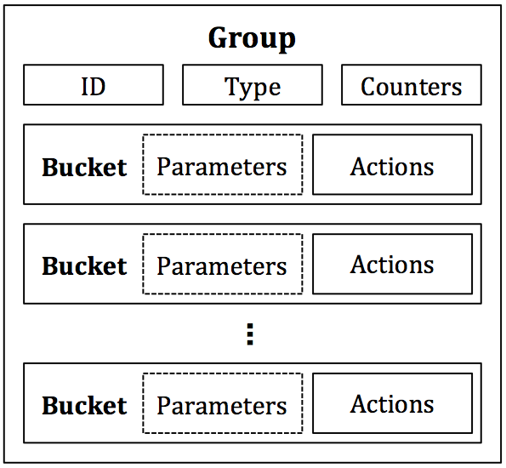
OpenFlow 1.3 Groups
Allow more complex actions
Bucket = (list of actions) + (optional params)
Actions can be unique per bucket
ALL, SELECT, INDIRECT, FAST FAILOVER

Slide 38
Community Support
Great software switch support
  OVS supports everything* except meters
    Present protocol support for meters
    Table features supported in 2.3.90 (master)
    Groups fully supported in 2.3.1
  ofsoftswitch supports meters but does not support all other OpenFlow 1.3 features
Hit-and-miss support with HW vendors
  Some vendors… H#, Br###de technically do, but buggy (or is it a feature?)
Wide controller support
*to my knowledge

Slide 39
Multi-Version OF Handshake
Handshake
  Message-exchanging process to establish an OpenFlow channel between a controller and a switch
  Need to negotiate common OpenFlow version
Algorithm
  Switch says “Hello version_X” with OF version X
  Controller says “Hello version_Y” with OF version Y
  Switch and controller each pick lower version of X and Y
    (theirs < mine) ? theirs : mine; e.g. (X < Y) ? X : Y;
Caveat…
  Algorithm requires support for each OF version up to and including the “Hello” version advertised
  Not the case in implementation/practice
Fix for (controller >= OF1.3) && (switch >= OF1.3)
  Hello advertises highest version + version bitmap for negotiation
slide provided by Ryan Izard

Slide 40

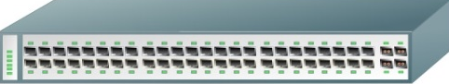
OpenFlow Auxiliary Connections
Multiple control connections per switch
  Parallelize some operations
  Negotiated on a per-switch basis
  Aux ID 0 = main; Aux ID > 0 = other
Controller chooses which connection to use
  Main
  Aux 1
  Aux 2
  …etc.
ID=0 (main)
ID=1
DPID=11:22:33:44:55:66:77:88
ID=2
slide provided by Ryan Izard

Slide 41
OpenFlow 1.3 Controller Roles
OpenFlow 1.3 integrates roles in protocol
  Role = controller read/write permissions for each switch
  MASTER + SLAVE
    Exactly one master controller per switch
    Zero or more slaves per switch
    Only the master controller can write
    All (other) slave controllers can read
  EQUAL
    All controllers can read and write
    Likely requires synchronization between controllers (e.g. HA)
But, doesn’t Nicira has role extension for OF 1.0?
  Same idea for MASTER and SLAVE
  Nicira’s OTHER role = OpenFlow 1.3’s EQUAL role
slide provided by Ryan Izard

Slide 42
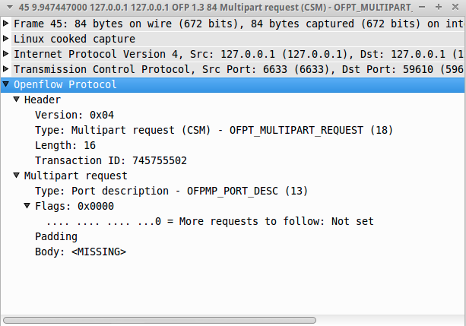
OpenFlow Multipart Messages
Steady-state controller-to-switch “queries”
Efficiently process large requests
Flow stats, port stats, group stats, meter stats, table features…
Request and reply pairs with same XID
OFPMPF_REQ_MORE flag for more messages
slide provided by Ryan Izard

Slide 43
Table Miss Behavior
What to do if a packet matches no flows?
Previously, a property of the flow table
  Typically, send to the controller
In OpenFlow 1.3, defined by a flow
  Zero-priority and fully-wildcarded match
  User-defined actions and instructions
  Can send to controller (most common)
  Or, can do what YOU want
slide provided by Ryan Izard

Slide 44

Table Features
Problem: Many OpenFlow features are optional, not required
Solution: Table Features specify capabilities of each table
  Matches, actions, instructions, etc.
Do table features indicate match co-dependencies or hardware vs. software support?
slide provided by Ryan Izard

Slide 45
Questions?

