Slide 1
Scaling Experiments

Slide 2
Contents of this tutorial
Recommended workflow for creating and scaling up experiments
Overview of available tools for automation
Overview of available tools for scaling up
Hands-on with Ansible

Slide 3
Recommended workflow
1. Build the smallest reasonable topology
2. Orchestrate and automate
3. Iterate and save your progress
4. Scale your experiment

Slide 4
1. Build the smallest reasonable topology
host
client
server
OVS
switch
router
host
host
router
router
master
worker
worker

Slide 5
2. Automate as you go
Use Configuration Management Systems to automate installation and configuration of software
Many tools available for this job: Ansible, Chef, Puppet, …

Slide 6
3. Save your progress
Log all of your experimental artifacts for every experiment that works
RSpec
image
install script
custom software
measurements
etc.
Use version control to store your artifacts
Always know the last configuration that worked

Slide 7
4. Scale your experiment
Only scale up when your smallest reasonable experiment is working
Adapt your request RSpec to add more nodes
Roll your own scaling script: mostly copy/pasting with minimal editing required
Use geni-lib

Slide 8
Some Definitions
Configuration Management
Ensure a computer system is in a specified state
Software Deployment
Install software onto a system
Push vs Pull
Server pushes onto the resource
Resource pulls configuration onto itself
Agent
Client software

Slide 9
CM Systems are Idempotent
CM systems are usually idempotent
Repeated runs generates the same state
Contrast to a shell script which encodes how to transition between two known states
The state is usually easy to describe.
iperf should be (or not be) installed
File foo.html should exist (or not)
Describing all possible transitions from every possible previous state is hard.
If iperf is not already installed, then install it, else do nothing
CM
?
CM
Unknown
State A
Known
State B
Idempotent
Shell script
A -> B
Known
State A
Known
State B
Idempotent

Slide 10
Compare/Contrast
 | Puppet | Ansible | Chef | Salt | Fabric
Push/Pull | Pull | Push | Push OR Pull | Push, pull and peer-to-peer | Push
Agent/Agentless | Agent | None | Agent | Agent | None
Authentication/Authorization | Certificates | SSH | SSH | PKI | SSH
Languages | ~ruby | YAML Jinga2 Python | ruby | Python YAML | Python

Slide 11
Ansible requirements
On the servers:
Your public key
Done by testbed
On the experiment controller:
Your private key on your “controller”
Inventory file which describes the experiment
Both provided by jFed
Ansible installed
✓
✓
✓

Slide 12
Ansible Characteristics
Push-based from a machine of choice
Manage nodes on-demand from any host with an ssh client
Can set up a server with recurring Ansible task
Facts are gathered for managed nodes before making changes to the node
Agentless on managed nodes
ssh is used for transport of config and code
Modules are run on nodes based on a playbook
Ansible modules are idempotent

Slide 13
Bottom Line: Characteristics
There is no need for you to do anything special to your experiment in order for you to use Ansible!

Slide 14
Ansible components
Inventory file
Contains ssh information, aliases, and groups
File format similar to ini
[ofx]
ofx1 ansible_ssh_host=ofx1.example.com
ofx2 ansible_ssh_host=ofx2.example.com
[clients]
client1 ansible_ssh_host=client1.example.com
client2 ansible_ssh_host=client2.example.com
client3 ansible_ssh_host=client3.example.com

Slide 15
Ansible components
Ansible modules
Idempotent functional building blocks
Many existing core and third-party modules
Users can write their own modules
No specific language required
Shortcuts exist for Python

Slide 16
Ansible components
Playbooks
Glue modules together and map to (set of) nodes
Mostly written in YAML with module-specific details
Template files written in Jinja2
---
- hosts: all
tasks:
- name: Install Nginx
apt: pkg=nginx state=installed update_cache=true

Slide 17
Bottom Line: Components
You can pick up basic Ansible by looking at examples. The languages are relatively simple and common.
If you know basic Python, you have the tools to be an Ansible power user!

Slide 18
Using Ansible in your experiment
2 scenario’s supported:
Run Ansible locally on your workstation
→ Best option for active development of your experiment
Add an extra node which acts as Ansible controller
→ Best option for creating a reproducible experiment

Slide 19
Ansible workflow on testbeds
Reserve resources
Run experiment
Create Ansible inventory
Create or modify playbook
Run
playbook
Dev-Test
cycle
Use jFed export function
Ansible modules
Testbed resources

Slide 20
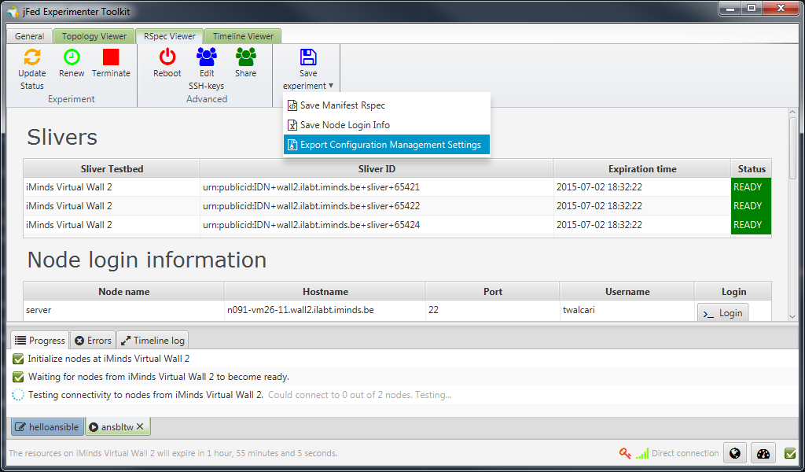
Retrieving Ansible configuration files from jFed

Slide 21
Do it yourself!
http://doc.ilabt.iminds.be/jfed-documentation/tutorials/helloansible.html

Slide 22
Ansible-service
<node client_id="ansible" exclusive="true" component_manager_id="urn:publicid:IDN+wall2.ilabt.iminds.be+authority+cm" xmlns:jfed="http://jfed.iminds.be/rspec/ext/jfed/1" >
<sliver_type name="raw-pc"/>
<services>
<install install_path="/local" url="http://users.ugent.be/~twalcari/hello-geni.tar.gz"/>
<execute shell="sh" command="cd /local &amp;&amp; sudo /bin/bash install-ansible.sh"
jfed:finished_flag="/tmp/ansible-install-finished"/>
<jfed:ansible inventory="/local/hosts" execute_playbook="/local/install-all.yml" />
</services>
</node>

Slide 23
Ansible-service
<node client_id="serverA" exclusive="true" component_manager_id="urn:publicid:IDN+wall2.ilabt.iminds.be+authority+cm">
<sliver_type name="raw-pc"/>
<jfed:ansible_group name="server"/>
</node>
Adds a node to a group in the inventory-file
ansible ansible_host=n063-16a.wall2.ilabt.iminds.be
[server]
serverA ansible_host=n063-17a.wall2.ilabt.iminds.be
[client]
client ansible_host=n063-18a.wall2.ilabt.iminds.be

Slide 24
Distribute SSH-keypair
<jfed:distribute_ssh_keypair
user="my_user_id" /* defaults to YOUR userId */
location="/local/my_id_rsa" /* defaults to ~/.ssh/id_rsa */
/>
Generates an SSH-keypair
Registers public-key for login access
Uploads private-key to all nodes in the experiment
In practice the default values are the ones you want:
<jfed:distribute_ssh_keypair />

Slide 25
Scaling manually: nodes
<rspec type="request" xmlns=…>
<node client_id="node0" exclusive="true" component_manager_id="urn:publicid:IDN+wall2.ilabt.iminds.be+authority+cm">
<sliver_type name="raw-pc"/>
</node>
</rspec>
Copy paste <node>-element with all its child elements
Change client_id of node to be unique

Slide 26
Scaling manually: nodes
<rspec type="request" xmlns=…>
<node client_id="node0" exclusive="true" component_manager_id="urn:publicid:IDN+wall2.ilabt.iminds.be+authority+cm">
<sliver_type name="raw-pc"/>
</node>
<node client_id="node1" exclusive="true" component_manager_id="urn:publicid:IDN+wall2.ilabt.iminds.be+authority+cm">
<sliver_type name="raw-pc"/>
</node>
</rspec>

Slide 27
Scaling manually: nodes with links
<rspec type="request" xmlns=…>
<node client_id="node0" exclusive="false" component_manager_id="urn:publicid:IDN+utahddc.geniracks.net+authority+cm">
<sliver_type name="default-vm"/>
<interface client_id="node0:if0">
<ip address="192.168.0.1" netmask="255.255.255.0" type="ipv4"/>
</interface>
</node>
<node client_id="node1" exclusive="false" component_manager_id="urn:publicid:IDN+utahddc.geniracks.net+authority+cm">
<sliver_type name="default-vm"/>
<interface client_id="node1:if0">
<ip address="192.168.0.2" netmask="255.255.255.0" type="ipv4"/>
</interface>
</node>
<link client_id="link0">
<component_manager name="urn:publicid:IDN+utahddc.geniracks.net+authority+cm"/>
<interface_ref client_id="node0:if0"/>
<interface_ref client_id="node1:if0"/>
<link_type name="lan"/>
</link>
</rspec>

Slide 28
Scaling manually
Copy paste <node>-element with all its child elements
Change client_id of node and interface to be unique
Change IP-addresses of interface to prevent duplicates
Add extra interface-reference in <link>
Pay attention to the details!

Slide 29
What is geni-lib?
Python library for creating RSpecs and querying the GENI Aggregate Manager API
Has additional tools to ease scaling up
→ http://groups.geni.net/geni/wiki/GEC21Agenda/ScalingUp
Allows you to:
Create RSpec requests programatically
List resources;
Create experiments;
Change experiments;
Query experiments;
…

Slide 30
Advantages / Disadvantages
Very powerful
Gives low-level access to the various resources
Requires a deep understanding of how the GENI AM API works
Little support for Fed4FIRE resources

Slide 31
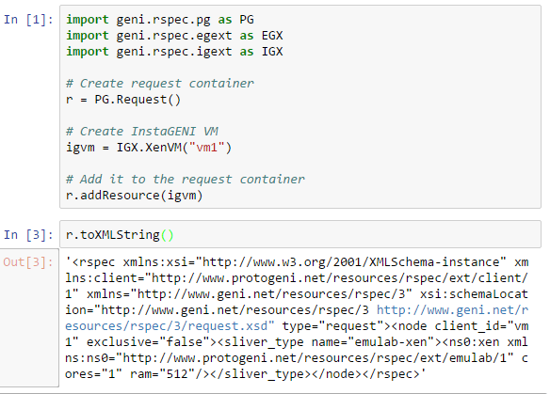
Example: Create an request

Slide 32
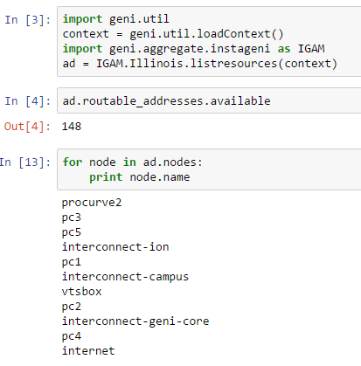
Example: Query available resources

Slide 33
Additional resources on geni-lib
Documentation:
https://geni-lib.readthedocs.io
Tutorial on scaling:
http://groups.geni.net/geni/wiki/GEC21Agenda/ScalingUp

